Slide 1
Quality Manual for Interoperability Testing
Morten Bruun-Rasmussen
mbr@mediq.dk
Presented by Jos Devlies, Eurorec

Slide 2
Quality and quality assurance
Quality in manufacturing
A measure, stating that a product is free from defects and significant variations
Quality in information technology product and services
Meeting the requirements of the customer
Quality Assurance
Any systematic process for ensuring quality
Quality and Quality Assurance for Interoperability Testing
An immature professional discipline

Slide 3
Quality in eHealth is a total concept
Quality at data entry
Quality of the application
Quality of the user
Quality in sharing data
Technical interoperability
Semantic interoperability
Quality in using
Integrated on-site decision support
Research (trials, post marketing surveillance,..) & Management
Quality needs to be
Assessed
Quality of assessment is essential

Slide 4
Quality Manual for Interoperability Testing
A brief look into:
Part I: Quality Management System
“Requirements for entities
performing Interoperability Testing”

Slide 5
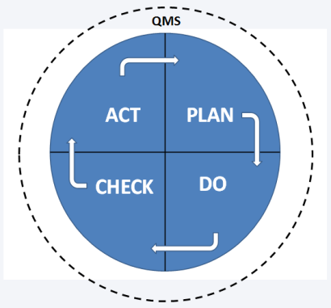
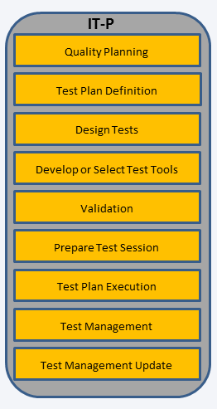
Quality Manual for Interoperability Testing Bodies
Part I
D2.1 Quality Management System
Part II
D2.2 Interoperability Testing Processes
CAB
Requirements for the operation of Conformity Assessment Bodies performing
Interoperability Testing

Slide 6
Quality Management System (one definition)
A Quality Management System is a set of interrelated or interacting elements
that organisations use to direct and control
how quality policies are implemented and quality objectives are achieved.
Source: ISO 9000: Quality Management Systems

Slide 7
Quality Management levels
Policy statements including clear objectives derives from the policy
Description of processes – how are the policy statements implemented
Supporting documents to be used to implement the policies

Slide 8
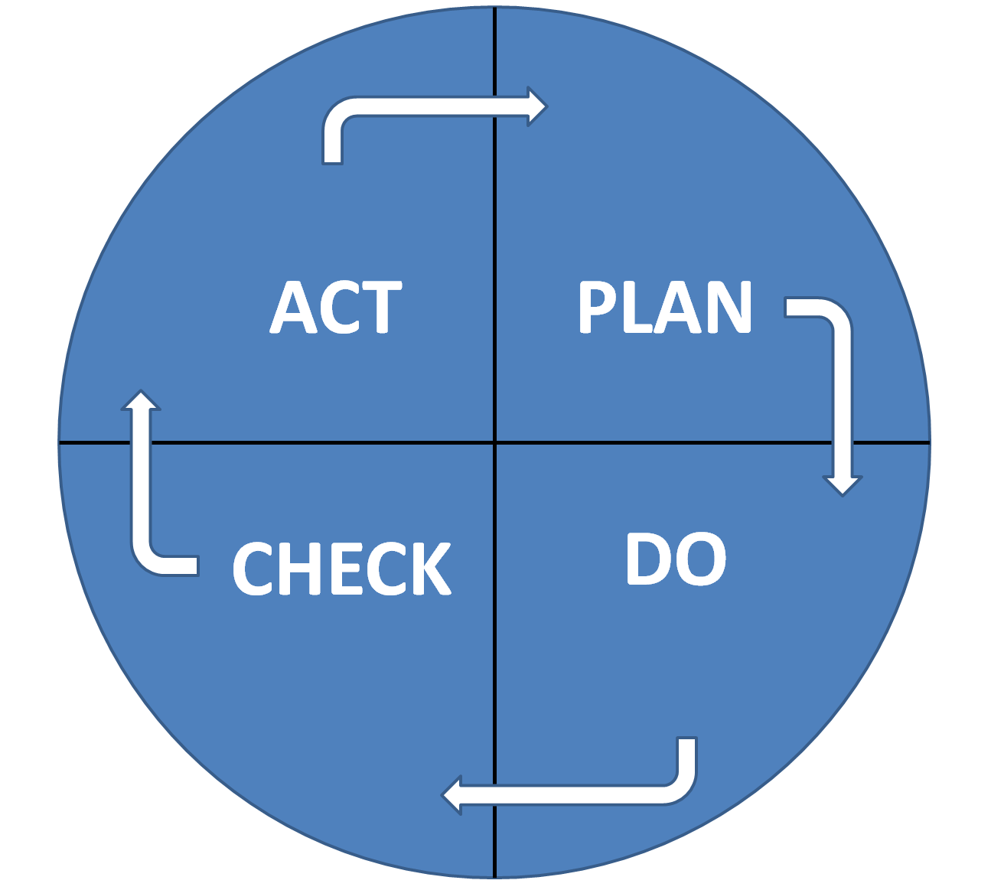
Quality Management System and the PDCA cycle
How to improve
next time?
What to do?
How to do it?
Do what was
planned
Did things happen
according to the plan?
Source: The Deming wheel (named after W. Edwards Deming).
A model for continuous improvement.

Slide 9
Requirements for management (1/2)
Organisation
Management system
Document control
General procedures
Approval and issue
Changes
Review of requests, tenders and contracts
Complaints
Control of nonconforming testing work

Slide 10
Requirements for management (2/2)
Improvement of the processes
Corrective action
Cause analysis
Selection and implementation of corrective actions
Monitoring of corrective actions
Preventive action
Control of records
Technical records
Internal audits
Management reviews

Slide 11
Requirements for: Personnel and test methods
Personnel
ensure the competence of all who perform test, evaluate results, and sign test reports
formulate the goals with respect to the education, training and skills of the Interoperability Test entity
use personnel who are employed by, or under contract to, the Interoperability Test entity
maintain job descriptions for managerial, technical and key support personnel involved in tests
Test methods
Use methods and procedures as described in the Quality Manual Part II. D2.2 Interoperability Testing Processes.

Slide 12
Quality Manual for Interoperability Testing
A brief look into:
Part II: Interoperability Testing Processes
“Quality Requirements for the Interoperability Testing Processes”

Slide 13
Quality Manual for Interoperability Testing Processes
Part I
D2.1 Quality Management System
Part II
D2.2 Interoperability Testing Processes
CAB
Requirements for the operation of Conformity Assessment Bodies performing
Interoperability Testing

Slide 14
Interoperability (one definition)
The ability of two or more
systems or components
to exchange information
and to use the information
that has been exchanged
Source: Institute of Electrical and Electronics Engineers.
IEEE Standard Computer Dictionary: A Compilation of IEEE Standard Computer Glossaries.
New York, NY: 1990.

Slide 15
Interoperability Testing Processes (IT-P): Scope
The Interoperability Testing Processes are generic and can be adjusted and customized by any Interoperability Testing entity
The Interoperability Testing Processes are a set of interconnected “guidelines” that describes how to run a test session from start to end.
Each process has defined input and output and can be maintained and improved in isolation and by different people with the required experience and skills.

Slide 16
IT-P: Actors and roles
Term | Definition
Top Level Management | The top level management coordinates the different activities. It gets reports from QA Manager, Test Manager and Auditors
QA Committee | A committee has the role to ensure the quality of the testing process, discusses the needs and decides on what needs to be done in terms of quality.
QA Manager | Manages the QA process. Gets input from the QA Committee and reports to Top Level Management.
Test Manager(TM) | Manages the testing. Organises the testing activities, reports to the Top Level Management. Follows the rules from the QA Committee to ensure the overall quality of the process
Testing team | Performs the tests and is under the supervision of the Test Manager.
System Under Test (SUT) Operators | SUT Operators execute their SUTs test steps required by the test
Auditors | Auditors verify that the QMS process is correctly used. The auditors report to the Top Level Management.

Slide 17
IT-P: Nine interconnected processes
Quality Planning
Test Plan Definition
Design Tests
Develop or Select Test Tools
Validation
Prepare Test Session
Test Plan Execution
Test Management
Test Management Update

Slide 18
IT-P: A generic template for each process
Why?
Objective
Work to be done
Risk planning
Roles and responsibilities
Checklist: How to adjust and localise the process description

Slide 19
Example: Test Plan Definition Why?
Interoperability Testing is a complex activity and can be clearly identified as a project on its own, with several tasks.
It is important to identify and allocate the right persons with testing skills as well as managers organising and monitoring the testing processes.
A good planning will help the individual testers to be sure that conformance and interoperability requirements are sufficient tested, independent of what person who performed the test.

Slide 20
Example: Test Plan Definition Objective
The test plan definition will describe the test strategy and its implementation.
All activities are carefully defined and planned in order to test profile specification in a given context.

Slide 21
Example: Process Test Plan Definition Work to be done
Definition of the scope and objective
Specification of the test design
Development or the selection of the test tools
Preparation of the test session:
Execution of the test session
Reporting of test results.

Slide 22
Example: Process Test Plan Definition Risk planning
The equilibrium between resources, schedule and the test design needs to be established.
A bad risk assessment and a weakness on the requirements specifications are also possible causes of failure.
If customers notice a weakness in the quality of products, they will no longer have confidence in the testing process of a particular project.
If the feedback to the organisation that has made the specification (eq. a profile for patient identification) is not well documented, the testing process has no sense or will be the bad quality.

Slide 23
Example: Test Plan Definition Roles and responsibilities
The test plan definition is under the responsibility of the Test Manager who organises the complete testing process.

Slide 24
Key message #1
A Quality Management System
will ensure continuous improvement of Interoperability

Slide 25
Key message #2
Quality Management
of Interoperability Testing
will improve eHealth deployment

Slide 26
Key message #3
A Quality Management System for
interoperability testing will facilitate the adoption of International eHealth standards

Slide 27
Thank you
More information on the Quality Manual
Part I: D2.1 Quality Management System for Interoperability Testing
Part II: D2.2 Interoperability Testing Processes
Is available on the Antilope website http://www.antilope-project.eu/

