Slide 1
Antilope – refinement of the eEIF
Vincent van Pelt vanpelt@nictiz.nl
Michiel Sprenger sprenger@nictiz.nl
Nictiz, the Netherlands
Notes:
The Antilope project is promoting the Europe-wide use internationally accepted guidelines for the realisation of national interoperability initiatives. This presentation deals with a refined eHealth European Interoperability Framework, that extends the EIF framework specifically for healthcare interoperability ICT

Slide 2
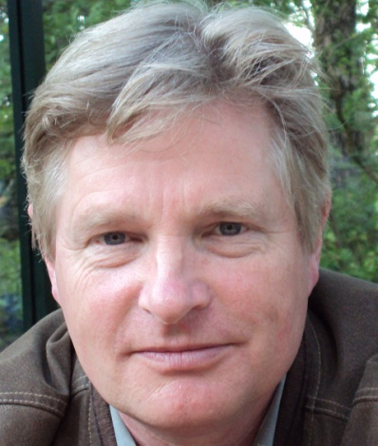
Introduction
Vincent van Pelt, MD
Michiel Sprenger, PhD
Nictiz, the Netherlands
National Healthcare ICT Competence Centre
Notes:
The core partners are shown on the first two rows, the Supporting Expert Partners are listed in the bottom two rows.

Slide 3
Antilope Core- and Expert Partners
Notes:
The core partners are shown on the first two rows, the Supporting Expert Partners are listed in the bottom two rows.

Slide 4
Antilope Validation Partners
Denmark, Norway, Sweden Finland, Iceland, Estonia, Lithuania, Latvia
Poland, Czech Republic, Slovakia, Hungary
Ireland, United Kingdom
Belgium, The Netherlands, Luxemburg
France, Switzerland,
Germany, Austria
Slovenia, Croatia, Serbia, Bosnia, FYE Macedonia, Montenegro
Italy, Malta
Portugal, Spain
Romania, Bulgaria, Greece, Cyprus, Turkey
Notes:
The validation partners organise multi-nation summits where the shared use of standards, guidelines, tools, interoperability terms, use cases, testing and validation methods, and labelling and certification initiatives are disseminated and promoted

Slide 5
Overview
Three key messages
Goals and deliverables of Antilope
eHealth European Interoperability Framework
Antilope Use Cases
Linking Use Cases to IHE and Continua Profiles
Templates for Use Cases and Realisation Scenarios
Refined interoperability schema
Three key messages (with solutions from Antilope)
Notes:
Overview of the following slides

Slide 6
Three key messages
Interoperability requires a shared definition of interoperability levels, terms and use cases
Use Cases are important building blocks in the realisation of interoperability
Using open, international standards and profiles in the implementation of Use Cases is a future-proof investment and facilitates cross-border solutions
Notes:
These are the 3 key messages we would like to have acknowledged. At the end of this presentation, the same key messages are shown, including the solutions that Antilope offers in these matters.

Slide 7
Goals
Refinement of eHealth European Interoperability Framework
Provide a comprehensive set of Use Cases that can be used throughout Europe as a basis for national and regional implementations
Provide tools and schemas that can assist in a shared understanding of interoperability issues
Educational material
For summits, discussions, collaborations and projects
Notes:
Starting point: the Use Cases that were selected by Deloitte from the eHealth European Interoperability Framework (report by Deloitte, 2012).
Goals: describe a number of internationally recognised use cases, provide suggestions for the use of standards and profiles in their deployment, and offer other tools for a shared understanding of interoperability levels and interoperability terms. See next slide for more details.
Second part: this presentation is part of that.

Slide 8
Deliverables
D1.1 Refinement Definition document
Refined eHealth European Interoperability Framework
Set of well-defined Use Cases, linking to interoperability Standards and Profiles (through Realisation Scenarios)
Templates for the description of Use Cases and Realisation Scenarios
Model for interoperability levels
Glossary of interoperability terms and definitions
Overview of the IHE and Continua Profiles mentioned in the Antilope Use Cases
Recommendations for governance and lifecycle
D1.2 Educational material
PowerPoint presentation (this presentation)
Refinement Definition document (see above)
Notes:
Refined eHealth European Interoperability Framework – see slide 8
Set of Use Cases – see slide 9
Linking to interoperability Standards and Profiles (through Realisation Scenarios) – see slides 10-14
Templates for description of Use Cases and Realisation Scenarios – see slide 14-16
Model for interoperability levels – see slide 17-21
Glossary of interoperability terms and definitions (no slides)
Overview of the IHE and Continua Profiles mentioned in the Antilope Use Cases (no slides)
Recommendations for governance and lifecycle (no slides)

Slide 9
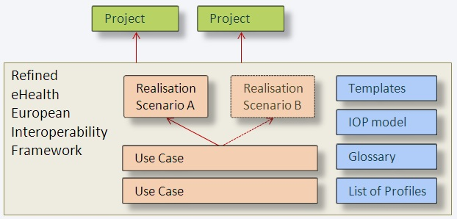
Antilope Interoperability Framework
Notes:
The Antilope eEIF offers the structured description of a number of interoperability Use Cases (on different organisational scales), and their accompanying Realisation Scenarios. These can be used as the basis for national and regional projects. Use Cases are implementation-independent, Realisation Scenarios describe a possible route towards implementation of that Use Case. For one Use case, more than one Realisation Scenario can be possible

Slide 10
1 - Antilope Use Cases
# | Medical domain | Description | Scale
1 | Medication | e-Prescription and e-Dispensing | 1a) Cross-border 1b) National/Regional 1c) Intra-hospital 1d) Citizens at home
2 | Radiology | Request and results sharing workflow for radiology | 2a) National/Regional 2b) Intra-hospital
3 | Laboratory | Request and results sharing workflow for laboratory | 3a) National/Regional 3b) Intra-Hospital
4 | Patient Summary | Patient Summary sharing | 4a) Cross-border 4b) National/regional 4c) Citizens at home
5 | Referral- and Discharge reporting | Cross-enterprise Referral and Discharge Reporting | National /Regional 5a) Referral of patient from primary to secondary care 5b) Discharge report from secondary care
6 | Participatory healthcare | Involvement by chronic patients in electronic documentation of healthcare information | Citizens at home
7 | Telemonitoring | Remote monitoring and care of people at home or on the move using sensor devices | Citizens at home
8 | Multidisciplinary consultation | Medical Board Review | National/Regional
Notes:
This is the list of the Use Cases. The second column indicates the medical domain of the Use Case, the right column indicates the ‘Sub-Use Cases’ that are relevant for different organisational levels: Cross-border, National/regional, Intra-hospital and citizens at home or on the move.
Note: National/regional means a jurisdictional entity. This can be a nation, or a region with its own organisation of healthcare

Slide 11
Linking Use Cases to Profiles
High-level Use Case
Functional description of the interactions between the participants in a process, for a certain purpose. Implementation-agnostic.
Realisation Scenario
High level direction for the realisation of a Use Case
Can be linked to interoperability Profiles.
Notes:
Describes the difference between a Use Case and a Realisation Scenario. Use Cases describe a process as seen from the endusers, without telling exactly how that should be implemented. They are implementation-agnostic.
Realisation Scenarios are implementation guidelines for the realisation of a use case. One Use Case may have more than one Realisation Scenario.
In the next slides, the relationship between Use cases and realisation Scenarios is explained in more detail.

Slide 12
Linking Use Cases to Profiles
Antilope Use Cases
Functional description of the interactions between the participants in a process. Implementation-agnostic
Consists of certain
Functionalities and transactions
Abstract processes (for instance, ‘patient login’, ‘create patient summary’ ‘patient consent’ et cetera)
that can be realised by adopting
Realisation Scenarios
High level direction for the realisation of a Use Case.
Can be linked to interoperability Profiles
That make use of
Profiles and Standards
Basic material for implementation guidelines (Profiles)
Notes:
Use cases describe a functional process
Realisation Scenarios describe a technical approach and architecture, with which the Use Case can be implemented
For a Realisation Scenario, certain high-level functionalities can be outlined.
These functionalities can be realised with the use of interoperability standards and profiles.

Slide 13
Use Cases and
Realisation Scenarios
Medication
Patient Summaries
Radiology workflow
Referral and discharge reports
Telehome monitoring
Laboratory workflow
Medical Board Review
Patient Data Entry
Consist of a combination of functionalities
Functionalities
Workflow interoperability
Workflow descriptions
Content
Document
Terminology
HCP Identification
Access Control
Patient Identification
Cross-community Services
Intra-community
Communication
can be implemented using Profiles
Profiles
IHE
Continua
…
are based upon standards
Standards
HL7
IHTSDO
LOINC
ISO
DICOM
CEN
GS1
…
Notes:
Here, the same flow is illustrated in a more practical manner.
Block 1 - In the first block, the Use Cases and Realisation Scenarios are described.
Block 2 - These Use Cases make use of certain functionalities (such as, logging in, patient discovery, scheduling, data encryption, et cetera).
Block 3 - Some of these functionalities can be realised using Standards and Profiles (for the Antilope Use cases, IHE and Continua Profiles have been selected).
Block 4 – IHE and Continua Profiles do not set their own standards, but describe the use of international standards in so-called Profiles, which can be seen as implementation guides for their deployment

Slide 14
Using Profiles to
realise functionalities in Realisation Scenarios
Workflow interoperability
Workflow descriptions
XDW Document Workflow
LTW Laboratory Testing Workflow
XBeR-WD Basic eReferral
SWF Scheduled Workflow (Radiol.)
XTB-WD Medical Board Review
CMPD Commun. Medic. PRE and DIS
Content
Document
Terminology
XPHR Exch. of Personal Health Record
DEN Document Encryption
SVS Shared Value Sets
XD-LAB Sharing Laboratory Results
DSG Document Signature
RTM Rosetta Terminology Mapping
DIS, PRE
MS Medical Summaries
DSUB Document Notification
LCSD Laboratory Code Sets Distribution
HCP Identification
Access Control
Patient Identification
HPD Healthcare Provider Discovery
XUA(++) Rights and Authorization
PIX/PDQ Patient Discovery
BPPC Patient Consent
PAM Patient Administration Mgt
XCPD Cross-Comm. Patient Discovery
Cross-community
Intra-community
Communication
XCA Cross-Community Access
XDS, XDR Document Sharing
HRN Health Record Network
ATNA Audit Trailing & NA
WAN, LAN, PAN Network protocols
CT Consistent Time
DEC Device-Enterprise Communic.
Notes:
In this slide, IHE and Continua Profiles have been mapped to the functionalities that were shown in the previous slide. The profiles in this slides are just the ones that are mentioned in the Antilope Use Cases / Realisation Scenarios, but this is a novel way of showing the IHE and Continua Profiles from functional grouping perspective.

Slide 15
2 - Templates for Use Case description
Structured description of Use Cases and accompanying Realisation Scenarios
Separate templates for the Use Case (= problem description ) and the Realisation Scenario (= solution direction )
Can be used for the structured description of additional Use Cases.
Notes:
Next subject: the Antilope Use Cases and Realisation Scenarios are described using templates for their description, so each Use Case is described in the same way. This also paves the way for further Use Cases in Europe. It is also a proposed way to describe high-level, healthcare interoperability Use Cases. The Use Cases are linked to interoperability Profiles and standards through the separate description of a Use Case (which is ‘implementation agnostic’), and one or more Realisation Scenarios, where a possible route for implementation is worked out and where its functions are linked to the use of Profiles. The Profiles offer a way to divide the Use Case into manageable parts that can be realised thorough these Profiles. Using these standards and profiles in the realisation of a interoperability process alleviates the burden of testing by using the standardized testing and certification methods for these Profiles, leaving only the ‘non-standard’ parts for testing on a national / regional, or project-level testing.

Slide 16
Use Case description template
Title | (Number and) Name of the Use Case
Purpose | The Purpose of a Use Case describes the objective that needs to be achieved, the goal of the use case. It also describes the relevance of the Use Case (both from the care process and the economical viewpoint).
Domain | The key functional domain of the Use Case: Medication, Radiology, Laboratory, Patient Summary, Referral and Discharge Reporting, Participatory healthcare, Telemonitoring, Multidisciplinary consultation
Scale | Organisational dimensions of the Use. The following scales have been defined for the Antilope Use Cases: Cross-border, National/regional, Intra-hospital, Citizens at home and on the move
Business Case | The Business Case explains the ‘why’ of the Use Case. It describes the relevance of the Use Case (both medical and economical). This part can contain a short SWOT analysis.
Context | Describes the current situation, influencing factors
Information | High-level description of what type of information is shared, like ‘patient summary’ or ‘medication prescription’
Participants | List of the main participants in the process. These can be individuals or organisational units. They are real-world parties.
Workflow steps | Real-world, functional description of a sequence of interactions between the participants in the different interaction steps of a process
Notes:
This table shows the different ‘sections’ that are used by Antilope to describe all the Use Cases. In the next slide, the template for the description of Realisation Scenarios is given.
For the selection of the different ‘sections’, many different use case templates have been used. These sections describe are proposed as a standard way of describing these high-level interoperability use cases.

Slide 17
Realisation Scenario description template
Title | (Number and) Name of the Realisation Scenario
Related Use Case | Use Case that this Realisation Scenario is related to
Scenario context | Information and background about the real-world scenario.
Actors | List of the main participating systems, also (confusingly) called Actors, in the process. In this context, an Actor is an ICT system, as opposed to a participant (see above). Actors are involved with each other through transactions.
Transactions | Interoperability workflow steps describing the process steps between systems, including the information that is exchanged.
Process flow | A numbered list of process steps (optionally accompanied by a schematic overview), describing transactions between systems (actors), and the information ‘units ’that are exchanged. The process flow describes the interoperability steps, i.e. the steps between the systems, and not the steps within the systems. The process flow can be linked to IHE and/or Continua Profiles. In this part, also swimming lanes and other schemas can be used
Linked Profiles | A list of Profiles that are relevant for the entire process flow, and a numbered list of the Profiles that can be linked to the Process flow steps.
Possible issues | Issues such as legislation and guidelines, social acceptance, language issues, architectural flaws, et cetera, that may affect the realisation of this scenario.
Notes:
This is the proposed template for the sections of the description of Realisation Scenarios. One of the most important sections is the linking of the Realisation Scenarios to the profiles that can be used to realise the scenario. Realisation Scenarios acknowledge the fact, that although the interoperability architectures in the countries and regions of Europe may be very different (such as central / federated architectures), the interoperability Profiles presented here may be used in different combinations to realise the Use Case. The IHE and continua Profiles allow the use of the different ‘modules’ to combine to the desired functionalities.

Slide 18
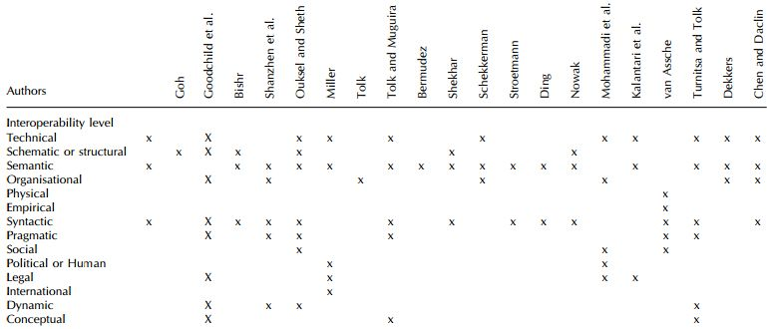
3 - Refined interoperability model
Background - many different approaches for arranging interoperability levels
Notes:
Next subject: a model for the uniform description of interoperability levels is presented here. It is one of the tools that is offered by the Antilope project to have a shared understanding of interoperability issues throughout Europe. This slide is meant to show that for the description of the levels of interoperability, a lot of proposal have been made, which have the intention of making things easier, but which eventually may even be more confusing than the real world situation.

Slide 19
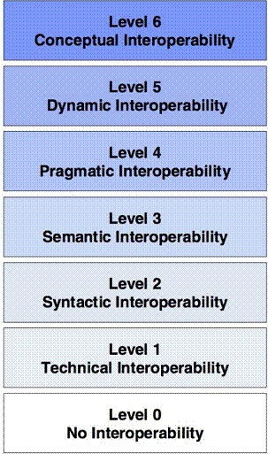
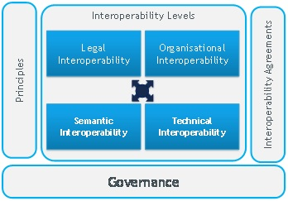
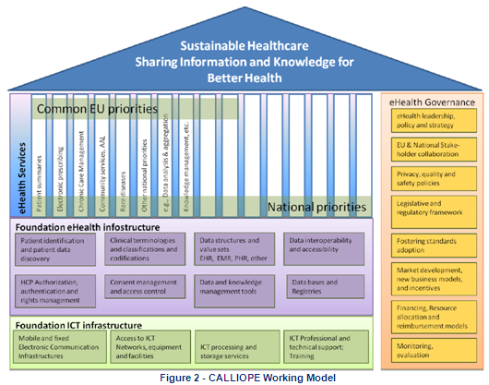
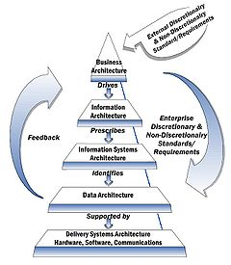
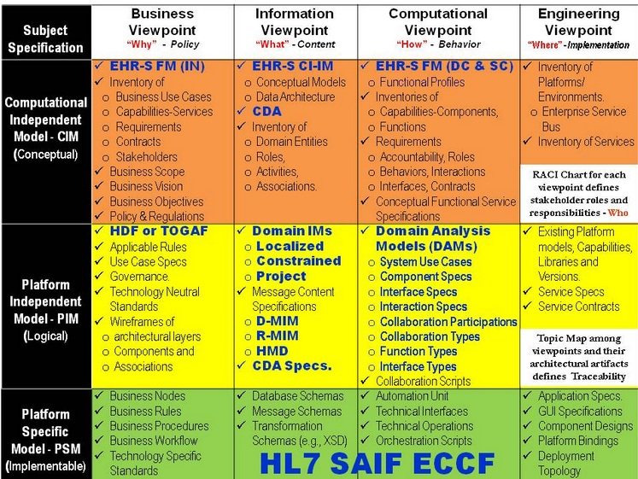
Many different representations
Background
Often:
too generic to be applicable, or
too technical to be understandable, or
too extensive to be practical
Notes:
This slide also shows that there are many different models for the representation of interoperability. Problems with these models can be summed up by the following remarks:
too generic to be applicable, or
too technical to be understandable, or
too extensive to be practical.
This is why a new proposition for the representation of interoperability levels is proposed by the Antilope project. The goal of this new representation is to have a simple model that describes the different levels of interoperability in non-technical terms, to be understood by all involved.

Slide 20
eEIF – current model
Legal
Organisational
Principles, Governance,
Agreements, Use Cases
From conceptual to technical
Semantic
Technical
Notes:
The current model has four categories. Here, they are arranged from conceptual to organisational to logical to technical interoperability.

Slide 21
eEIF – refined model
Legal
Legal and regulatory
Legal and regulatory constraints
Policy
Collaboration agreements
Organisational
Care Process
Alignment of care processes
Security, Governance
Standards and Profiles, Certification
Semantic
Information
Meaning and format of information
Applications
Integration in healthcare systems
Technical
IT Infrastructure
Communication protocols
Notes:
For the medical domain, a refined EIF model is proposed, based upon the EIF model. More layers are needed to reflect the practical interoperability issues on different organisational levels.
Legal: here, the legal and regulatory constraints for health information exchange are checked.
Organisational: split into Policy (high level contracts and agreements between organisations) and Care Process (alignment of medical processes).
Semantic: the term ‘Information’ contains both semantic and syntactic interoperability. In this layer, both the content and its format are described
Technical: Split into Applications and IT Infrastructure. In the Applications layer, import and export of information is managed. In the IT Infrastructure layer, communication and networking protocols are defined.

Slide 22
Interoperability means alignment on different levels
Interoperability between organisations
Organisation A
Organisation B
Legal and regulatory
Compatible legislation and regulations
Legal and regulatory
Policy
Collaboration agreements
Policy
Care Process
Alignment of care processes and workflows
Care Process
Information
Datamodel, terminologies, formatting
Information
Applications
Integration in healthcare applications
Applications
IT Infrastructure
Communication- and network protocols
IT Infrastructure
Notes:
This is the basic interoperability level model. Its main advantages are:
Overview of the different interoperability aspects
Understandable by all stakeholders
Show the different levels of interoperability from an ‘outsider’ point of view
Based upon existing interoperability models
The two vertical bars are combinations of factors that are important all the horizontal levels of interoperability

Slide 23
eEIF – stakeholders
Legal
Legal and regulatory
Regulators and advisors
Healthcare managers
Policy
Policy makers
Organisational
Healthcare professionals
Care Process
Information architects, business analysts
Security, Governance
Standards and Profiles, Certification
Semantic
Information
Information analysts, coders
System engineers
Applications
Technical
System architects
IT Infrastructure
Notes:
Different parties are involved in the different layers of interoperability.

Slide 24
eEIF – linking to standards and profiles
Legal and regulatory
Laws, healthcare guidelines
Policy
(Standardised) contracts
Care Process
Use Cases , IHE-XDW
Security, Governance
Standards and Profiles, Certification
Information
HL7, IHE, SNOMED-CT, LOINC
Applications
IHE, CHA, HL7
IT Infrastructure
IHE-XDS, CHA, XML, RESTful, TCP-IP
Notes:
Standards on different levels of interoperability.

Slide 25
eEIF –refined interoperability model
Legal and regulatory
Policy
Care Process
Security, Governance
Standards and Profiles, Certification
Information
Applications
IT Infrastructure
Notes:
For the medical domain, a refined EIF model is proposed, based upon the EIF model. More layers are needed to reflect the practical interoperability issues on different organisational levels.
Legal: first you need to know what the constraints for health information exchange are
Organisational: split into Policy (management level agreements between organisations) and Care Process (alignment of medical processes)
Semantic: the term ‘Information’ contains both semantic and syntactic interoperability. In this layer, both the content and its format are described
Technical: Split into Applications and IT Infrastructure. In the Applications layer, import and export of information is managed. In the IT Infrastructure layer, communication and networking protocols are defined.

Slide 26
Three key messages
Interoperability requires a shared definition of interoperability levels, terms and use cases | Antilope offers a set of Use Cases, a glossary of interoperability terms and definitions, a schema for interoperability levels, and a template for the description of use cases.
Use Cases are important building blocks in the realisation of interoperability | The Antilope Use Cases can be used as practical starting points for national/regional eHealth projects.
Using open, international standards and profiles in the implementation of Use Cases is a future-proof investment and facilitates cross-border solutions | The Antilope Use Cases are linked to proven and widely accepted standards and profiles.
Notes:
This slide shows the key messages that ere stated in the beginning of this presentation. The second column states the solutions that are offered to realise the statements that are made in the first column

Slide 27
Further information
More information is available at the Antilope website:
http://www.antilope-project.eu/
Notes:
This is the last slide of this presentation.

