Slide 1
Adoption and take up of standards and profiles for e-Health Interoperability
Jos Devlies, EuroRec, Belgium
based on a presentation by Ib Johanson, MedCom , DK

Slide 2
Antilope
ANTILOPE
Thematic network
To promote use of standards and profiles for e-Health interoperability and
To foster their adoptions across EU

Slide 3
The need for interoperability
Quality and efficiency of care are prerequisites for affordable care.
Quality is never granted for free.
Efficiency requires sharing and reuse of clinical data.
None of these goals can be realised without interoperability.
Interoperable services requires standards based
data exchange services
content definition
Interoperability identified by the eHealth European Interoperability Framework as a priority.
Interoperability and Quality needs to be proven: certification

Slide 4
Interoperability (one definition)
The ability of two or more
systems or components
to exchange information
and to use the information
that has been exchanged
Source: Institute of Electrical and Electronics Engineers.
IEEE Standard Computer Dictionary: A Compilation of IEEE Standard Computer Glossaries.
New York, NY: 1990.

Slide 5
Antilope Background, purpose, outcome
Digital Agenda and eHealth action plan 2012-2020
European Projects:
2008-2013 – EpSOS : specifications of the cross border exchange of medical data
2009-2012 – EHR-Q^{TN} : Quality and Certification of EHR systems
2010-2011 - HITCH (Healthcare Interoperability testing and Conformance Harmonisation) : eHealth Interoperability roadmap
2012 - eEIF: eHealth Interoperability Framework
2013 – 2015- Antilope, Interoperability Standards

Slide 6
Antilope, Background, purpose, outcome
HITCH:
There is a need for a widely accepted quality guide for interoperability testing based on existing quality standards.
An organized collaboration is needed to reduce the fragmentation and lack of maturity in interoperability test tools and test plans in specific areas.

Slide 7
Antilope, Background, purpose, outcome
Antilope a thematic network:
Develop documentation and educational materials:
related to existing standards and profiles
for eHealth interoperability mentioned in the eEIF report
Drive adaption and improve the standard development process
Define QA testing guidelines for interoperability
Propose a quality assessed labelling and certification process (EU level and national level)

Slide 8
Antilope Core and Expert Partners

Slide 9
Antilope Validation Partners
Denmark, Norway, Sweden Finland, Iceland, Estonia, Lithuania, Latvia
Poland, Czech Republic, Slovakia, Hungary
Ireland, United Kingdom
Belgium, The Netherlands, Luxemburg
France, Switzerland,
Germany, Austria
Slovenia, Croatia, Serbia, Bosnia, FYE Macedonia, Montenegro
Italy, Malta
Portugal, Spain
Romania, Bulgaria, Greece, Cyprus, Turkey

Slide 10
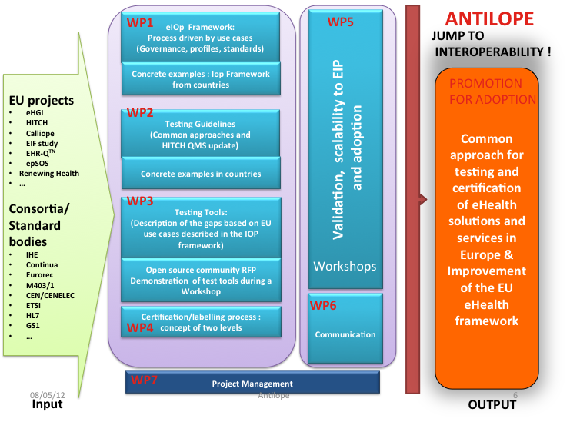
Antilope, Background, purpose, outcome


Slide 11
Input / output in Antilope
WP1: eHealth Interoperability Framework
WP7: Project Management
WP6: Communication
WP2: Quality Manual for IOP Testing
WP3: Testing Tools
WP4: Labelling and Certification Process
WP5: Validation, Scalability to EIP and Adoption

Slide 12
Purpose of the Summit
To agree that
interoperability is essential for care safety and cost containment
interoperability of eHealth systems should never be taken as given.
to achieve interoperability use of appropriate standards and profiles supported by appropriate testing is needed.
interoperability testing should be based on a Quality Management System using testing tools
the eHealth European Interoperability framework is the first step in harmonising interoperability efforts over Europe (at country, region or local level).
To bring you to the point to
include in your regulatory framework the concepts of proven and certified functional quality requirements, to reach national as well as cross border interoperability
To partner towards interoperability

Slide 13
Presenting Antilope results
Antilope results cover four complementary areas
Each area will be presented in a similar way through:
Key statements summarising the findings
Additional background information elaborating the topic in more detail
Some of these statements will be debated afterwards
Your opinion will become part of the Antilope guidance through a questionnaire

Slide 14
.. but before presenting the Antilope approach
We will listen to National Strategy and Status Reports on Interoperability in the region
Title
Interoperability & Testing in The Netherlands | Lies van Gennip, NICTIZ
Interoperability & Functional Testing in Belgium | Luc Nicolas, FOD/SPF Santé
Interooperability in Luxembourg

Slide 15
Antilope, Background, purpose, outcome
Outcome
Common approach for testing and certification through
recommendations for reaching interoperability
Based on:
Use cases
Quality manual – Quality process
Selected tools
Certification and labelling
Educational material
Input from Regional summits

Slide 16
Thank you to Alexander and his team
Thank you for being with us

