Slide 1
Adoption and take up of standards and profiles for eHealth Interoperability
Summit Presentation

Slide 2
Topics addressed
Why ANTILOPE?
The ANTILOPE Consortium
Requirements for Interoperability
The ANTILOPE Approach towards interoperability
In a stepwise approach (use case per use case)
Proving quality and interoperability of eHealth solutions
Using quality assessed tools and procedures
Purpose of the Summit
Notes:
REVIEW VVP: Bullet 3: Requirements for Interoperability -> Requirements for interoperability
Bullet 4: I miss the mentioning of standards and profiles here.

Slide 3
The need for interoperability
Quality and efficiency of care are prerequisites for cost containment (and huge cost savings).
Can only be realised through sharing and reuse of clinical data and integrated knowledge.
Sharing and reuse requires systems and interoperable data exchange services able to produce, to exchange and to interpret appropriate content.
Interoperability was identified by the eHealth European Interoperability Framework as a priority.
Quality and interoperability should be guaranteed to the users and the community through a trustworthy quality assured process of quality labelling and certification.
Notes:
REVIEW VVP: Bullet 1: remove the word ‘huge’
Bullet 2: Change ‘Can’ into ‘These can’ at the beginning of the sentence

Slide 4
What’s the solution?
The large scale adoption and effective use of standards and profiles in eHealth in order to reach more and more interoperability.
Consider recommendations of the eEIF regarding stepwise use case based approach.
Harmonised but also flexible way across Europe, enabling national variation.
Through appropriate investments in health logistics and health infostructure.
Notes:
REVIEW VVP: Bullet 4: infostructure is not a standing term, and I miss the infrastructure. Proposal for this sentence:
‘Through appropriate investments in health infrastructure, infostructure and logistics’

Slide 5
Why the ANTILOPE Project?
Consortium of
organisations and experts involved in :
standards development and project specifications
interoperability testing
quality labelling and certification processes
organisations representing users, industry and health authorities
Optimise legacy of the HITCH (interoperability) and the
EHR-Q^{TN} (quality labelling and certification) projects
Involvement of the partners in the eHealth European Interoperability Framework project
Notes:
REVIEW VVP: This was introduces in the first slide as the first subject. So why is it here? Maybe look at the order again

Slide 6
Antilope Core and Experts Partners

Slide 7
Antilope Validation Partners
Denmark, Norway, Sweden Finland, Iceland, Estonia, Lithuania, Latvia
Poland, Czech Republic, Slovakia, Hungary
Ireland, United Kingdom
Belgium, The Netherlands, Luxemburg
France, Switzerland,
Germany, Austria
Slovenia, Croatia, Serbia, Bosnia, FYE Macedonia, Montenegro
Italy, Malta
Portugal, Spain
Romania, Bulgaria, Greece, Cyprus, Turkey

Slide 8
Purpose of the Summit
To convince you that
interoperability is essential for care safety and cost containment
interoperability of eHealth systems should never be taken as given. To achieve interoperability use of appropriate standards and profiles supported by appropriate testing is needed.
quality proving should be based on a Quality Management System using standard based tools
the eHealth European Interoperability framework is the first step in harmonising interoperability efforts over Europe (at country, region or local level).
To bring you to the point to include in your regulatory framework the concepts of proven and certified
functional quality requirements
to reach national as well as cross border interoperability
To partner towards interoperability
Notes:
REVIEW VVP: Bullet 1: I think the word ‘convince’ is a bit too hierarchical. Most participants will already agree on most of our recommendations.
Maybe: ‘To create shared agreement that’
Bullet 2: Change to: To bring you to the point to include the concepts of proven and certified functional quality requirements in your regulatory framework, to reach both national and cross-border interoperability
Bullet 3: with whom?

Slide 9
Presenting Antilope results
Antilope results cover four complementary areas.
Each area will be presented in a similar way through:
Key statements summarising the findings
Additional background information elaborating the topic in more detail
Some of these statements will be debated afterwards
Your opinion will be kept and part of the Antilope guidance through a questionnaire
End up with an appeal to “do”
Notes:
REVIEW VVP: Bullet 1: remove ‘.’ at the end of the line. Also, describe the four items in sub-bullets
Bullet 2: add ‘key’ before ‘statement’
Bullet 4: change to: ‘Your opinion will become part of the Antilope educational material through a questionnaire.
Bullet 5: ??

Slide 10
Interoperability (one definition)
The ability of two or more
systems or components
to exchange information
and to use the information
that has been exchanged
Source: Institute of Electrical and Electronics Engineers.
IEEE Standard Computer Dictionary: A Compilation of IEEE Standard Computer Glossaries.
New York, NY: 1990.

Slide 11
Requirements for Interoperability
Interoperability includes
Access to reliable and high quality resources
Clinical care data
Health and Care Knowledge
Ability to use those common resources
--------
Systems requirements to get that quality
Reliable and trustworthy systems and solutions able to
Identify and label properly clinical content
Considering knowledge and context
Logistics for sharing and exchanging medical data in a secured environment
Notes:
REVIEW VVP: Change ‘Interoperability’ to ‘interoperability’.
Bullet 1: there is ‘--------’ after the second sub-bullet. Should it be removed, or filled in by an example?
Bullet 2: first sub-bullet: change the two sub-sub bullets to 1 for better readability, so: ‘Identify and label properly clinical content, considering knowledge and context’

Slide 12
Interoperability and the ALT-model
Organisational
level
Continuity and quality
presentation
presentation
Application
level
Clinical
Interoperability
functionality
functionality
clinical content
clinical content
Logical
level
terminology
terminology
Semantic
interoperability
model
model
Technical
level
format & storage
format & storage
Technical
interoperability
transmission
transmission
Communication
Notes:
REVIEW VVP: I would put the WP1 interoperability level schema here (see slide 28)

Slide 13
Main ANTILOPE topics
To foster interoperability we need well defined use cases and the related standards and profiles identified / available
Refined eHealth European Interoperability Framework
Quality and Interoperability needs to be proven in a trustworthy way.
Quality Labelling and Certification
Reliable tools are needed to assess interoperability services and products.
Interoperability Testing Tools
Testing, testing procedures and testing tools are quality assessed on their own
Quality Management System
How to realise in my country?
Stepwise
Notes:
REVIEW VVP: Bullet 5: Change ‘Stepwise’ to ‘Stepwise approach’

Slide 14
Antilope – refinement of the eEIF
Notes:
The eHealth European Interoperability Framework identified a number of use cases as preferential wharfs for investment. The ANTILOPE project extends the use case based approach of the EIF framework for large scale roll out of interoperable eHealth services.

Slide 15
Three key messages
Interoperability requires a shared definition of interoperability levels, terms and use cases.
Use Cases are important building blocks in the realisation of interoperability.
Using open, international standards and profiles in the implementation of Use Cases is a future-proof investment and facilitates cross-border solutions

Slide 16
eHealth European Interoperability Framework
Goals of Antilope regarding eEIF
Refined interoperability schema
Extend and refine eEIF use cases, adding Antilope use cases to realise a comprehensive set
Link Use Cases to IHE and Continua Profiles
Define templates for Use Cases definition and Realisation Scenarios
Other related goals
Model for interoperability levels
Glossary of interoperability terms and definitions
Overview of profiles (IHE, Continua) to be used in the use cases
Recommendations for governance and lifecycle
Notes:
Refined interoperability schema (slide 64)
Extend and refine eEIF use cases, adding Antilope use cases to realise a comprehensive set (slide 65)
Link Use Cases to IHE and Continua Profiles
Define templates for Use Cases definition and Realisation Scenarios

Slide 17
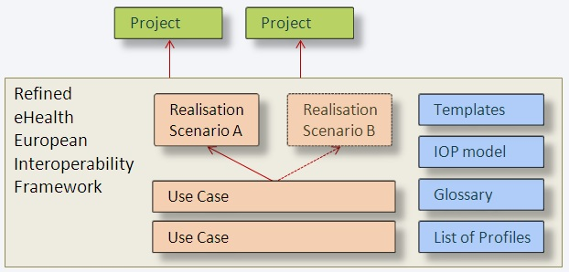
Antilope Interoperability Framework
Notes:
The Antilope eEIF offers the structured description of a number of interoperability Use Cases (on different organisational scales), and their accompanying Realisation Scenarios. These can be used as the basis for national and regional projects. Use Cases are implementation-independent, Realisation Scenarios describe a possible route towards implementation of that Use Case. For one Use case, more than one Realisation Scenario can be possible

Slide 18
Antilope Use Cases
# | Medical domain | Description | Scale
1 | Medication | e-Prescription and e-Dispensing | 1a) Cross-border 1b) National/Regional 1c) Intra-hospital 1d) Citizens at home
2 | Radiology | Request and results sharing workflow for radiology | 2a) National/Regional 2b) Intra-hospital
3 | Laboratory | Request and results sharing workflow for laboratory | 3a) National/Regional 3b) Intra-Hospital
4 | Patient Summary | Patient Summary sharing | 4a) Cross-border 4b) National/regional 4c) Citizens at home
5 | Referral- and Discharge reporting | Cross-enterprise Referral and Discharge Reporting | National /Regional 5a) Referral of patient from primary to secondary care 5b) Discharge report from secondary care
6 | Participatory healthcare | Involvement by chronic patients in electronic documentation of healthcare information | Citizens at home
7 | Telemonitoring | Remote monitoring and care of people at home or on the move using sensor devices | Citizens at home
8 | Multidisciplinary consultation | Medical Board Review | National/Regional
Notes:
This is the list of the Use Cases. The second column indicates the medical domain of the Use Case, the right column indicates the ‘Sub-Use Cases’ that are relevant for different organisational levels: Cross-border, National/regional, Intra-hospital and citizens at home or on the move.
I

Slide 19
Initial steps for implementing use cases
High-level Use Case Functional Description
Is the first step towards implementation
Functional description of the interactions between the participants in a process, for a certain purpose.
Implementation-agnostic.
Realisation Scenario
High level direction / options for the realisation of a Use Case
Implementation guidelines for concrete realisation
Can be linked to Interoperability Profiles.
Notes:
Describes the difference between a Use Case and a Realisation Scenario.
- Use Cases describe a process as seen from the endusers, without telling exactly how that should be implemented. They are implementation-agnostic.
- Realisation Scenarios are implementation guidelines for the realisation of a use case. One Use Case may have more than one Realisation Scenario.
In the next slides, the relationship between Use cases and realisation Scenarios is explained in more detail.

Slide 20
Linking Use Cases to Profiles
Antilope Use Cases
Functional description of the interactions between the participants in a process
can be realised through
Antilope Realisation Scenarios
High level direction for the realisation of a Use Case
make use of
Functionalities, transactions
Abstract processes (for instance, ‘patient login’)
can be implemented using
Profiles and Standards
Guidelines for standards-based implementation
Notes:
Use cases describe a functional process
Realisation Scenarios describe a technical approach and architecture, with which the Use Case can be implemented
For a Realisation Scenario, certain high-level functionalities can be outlined.
These functionalities can be realised with the use of interoperability standards and profiles.

Slide 21
Use Cases and
Realisation Scenarios
Medication
Patient Summaries
Radiology workflow
Referral and discharge reports
Telehome monitoring
Laboratory workflow
Medical Board Review
Patient Data Entry
Consist of functionalities
Functionalities
Workflow interoperability
Workflow descriptions
Content
Document
Terminology
HCP Identification
Access Control
Patient Identification
Cross-community Services
Intra-community
Communication
can be implemented with Profiles
Profiles
IHE
Continua
…
are based upon standards
Standards
HL7
IHTSDO
LOINC
ISO
DICOM
CEN
GS1
…
Notes:
Here, the same flow is illustrated in a more practical manner.
Block 1 - In the first block, the Use Cases and Realisation Scenarios are described.
Block 2 - These Use Cases make use of certain functionalities (such as, logging in, patient discovery, scheduling, data encryption, et cetera).
Block 3 - Some of these functionalities can be realised using Standards and Profiles (for the Antilope Use cases, IHE and Continua Profiles have been selected).
Block 4 – IHE and Continua Profiles do not set their own standards, but describe the use of international standards in so-called Profiles, which can be seen as implementation guides for their deployment

Slide 22
Using Profiles to
realise functionalities
Workflow interoperability
Workflow descriptions
XDW Document Workflow
LTW Laboratory Testing Workflow
XBeR-WD Basic eReferral
SWF Scheduled Workflow (Radiol.)
XTB-WD Medical Board Review
CMPD Commun. Medic. PRE and DIS
Content
Document
Terminology
XPHR Exch. of Personal Health Record
DEN Document Encryption
SVS Shared Value Sets
XD-LAB Sharing Laboratory Results
DSG Document Signature
RTM Rosetta Terminology Mapping
DIS, PRE
MS Medical Summaries
DSUB Document Notification
LCSD Laboratory Code Sets Distribution
HCP Identification
Access Control
Patient Identification
HPD Healthcare Provider Discovery
XUA(++) Rights and Authorization
PIX/PDQ Patient Discovery
BPPC Patient Consent
PAM Patient Administration Mgt
XCPD Cross-Comm. Patient Discovery
Cross-community
Intra-community
Communication
XCA Cross-Community Access
XDS, XDR Document Sharing
HRN Health record Network
ATNA Audit Trailing & NA
WAN, LAN, PAN Network protocols
CT Consistent Time
DEC Device-Enterprise Communic.
Notes:
Here, the same flow is illustrated in a more practical manner.
Block 1 - In the first block, the Use Cases and Realisation Scenarios are described.
Block 2 - These Use Cases make use of certain functionalities (such as, logging in, patient discovery, scheduling, data encryption, et cetera).
Block 3 - Some of these functionalities can be realised using Standards and Profiles (for the Antilope Use cases, IHE and Continua Profiles have been selected).
Block 4 – IHE and Continua Profiles do not set their own standards, but describe the use of international standards in so-called Profiles, which can be seen as implementation guides for their deployment

Slide 23
How to start from a selected use case implementation?
Structured description of
Use Cases
Realisation Scenarios (accompanying)
Make use of the ANTILOPE Template for
Use Case => problem description
Realisation Scenario => solution direction )
Description of the templates for your information and detailed available in the deliverable.
Notes:
the Antilope Use Cases and Realisation Scenarios are described using templates for their description, so each Use Case is described in the same way. This also paves the way for further Use Cases in Europe. It is also a proposed way to describe high-level, healthcare interoperability Use Cases. The Use Cases are linked to interoperability Profiles and standards through the separate description of a Use Case (which is ‘implementation agnostic’), and one or more Realisation Scenarios, where a possible route for implementation is worked out and where its functions are linked to the use of Profiles.

Slide 24
Use Case description template
Title | (Number and) Name of the Use Case
Purpose | The Purpose of a Use Case describes the objective that needs to be achieved, the goal of the use case. It also describes the relevance of the Use Case (both from the care process and the economical viewpoint).
Domain | The key functional domain of the Use Case: Medication, Radiology, Laboratory, Patient Summary, Referral and Discharge Reporting, Participatory healthcare, Telemonitoring, Multidisciplinary consultation
Scale | Organisational dimensions of the Use. The following scales have been defined for the Antilope Use Cases: Cross-border, National/regional, Intra-hospital, Citizens at home and on the move
Business Case | The Business Case explains the ‘why’ of the Use Case. It describes the relevance of the Use Case (both medical and economical). This part can contain a short SWOT analysis.
Context | Describes the current situation, influencing factors
Information | High-level description of what type of information is shared, like ‘patient summary’ or ‘medication prescription’
Participants | List of the main participants in the process. These can be individuals or organisational units. They are real-world parties.
Workflow steps | Real-world, functional description of a sequence of interactions between the participants in the different interaction steps of a process
Notes:
These sections describe are proposed as a standard way of describing these high-level interoperability use cases.

Slide 25
Realisation Scenario description template
Title | (Number and) Name of the Realisation Scenario
Related Use Case | Use Case that this Realisation Scenario is related to
Scenario context | Information and background about the real-world scenario.
Actors | List of the main participating systems, also (confusingly) called Actors, in the process. In this context, an Actor is an ICT system, as opposed to a participant (see above). Actors are involved with each other through transactions.
Transactions | Interoperability workflow steps describing the process steps between systems, including the information that is exchanged.
Process flow | A numbered list of process steps (optionally accompanied by a schematic overview), describing transactions between systems (actors), and the information ‘units ’that are exchanged. The process flow describes the interoperability steps, i.e. the steps between the systems, and not the steps within the systems. The process flow can be linked to IHE and/or Continua Profiles. In this part, also swimming lanes and other schemas can be used
Linked Profiles | A list of Profiles that are relevant for the entire process flow, and a numbered list of the Profiles that can be linked to the Process flow steps.
Possible issues | Issues such as legislation and guidelines, social acceptance, language issues, architectural flaws, et cetera, that may affect the realisation of this scenario.
Notes:
These sections describe are proposed as a standard way of describing these high-level interoperability use cases.

Slide 26
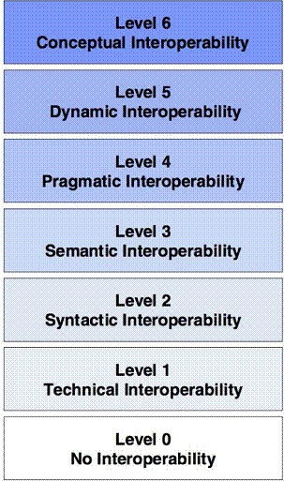
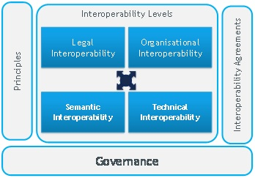
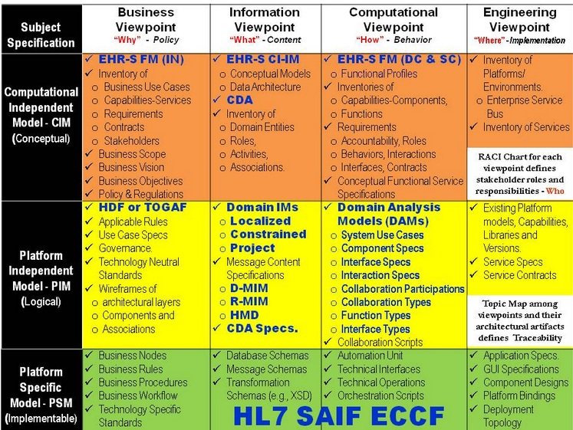
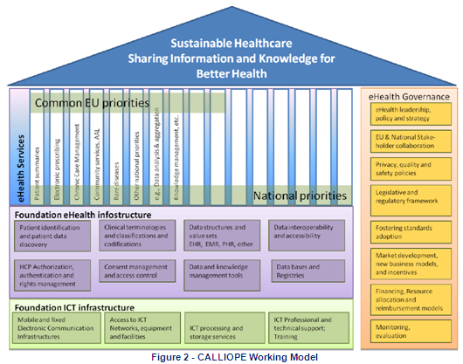
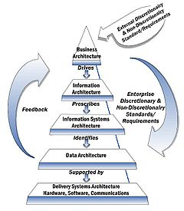
Many different representations
Interoperability levels - history
Often:
too generic to be applicable, or
too technical to be understandable, or
too extensive to be practical
Notes:
This slide is meant to show that for the description of the levels of interoperability, a lot of proposal have been made, which have the intention of making things easier. They did not succeed due to different viewpoints, axes of distinction between levels, overlapping levels, etc.
A model for the uniform description of interoperability levels offered by the Antilope project to have a shared understanding of interoperability issues throughout Europe

Slide 27
Refined interoperability schema
Antilope interoperability schema
Legal and regulatory
Policy
Care Process
Security, Governance
Standards and Profiles, Certification
Information
Applications
IT Infrastructure
Notes:
This is the basic interoperability level model. Its main advantages are:
Overview of the different interoperability aspects
Understandable by all stakeholders
Show the different levels of interoperability from an ‘outsider’ point of view
Based upon existing interoperability models
The two vertical bars are combinations of factors that are important all the horizontal levels of interoperability

Slide 28
Refined interoperability schema
Activities for reaching interoperability in the different layers
Legal and regulatory
Compatible legislation and regulations
Policy
Collaboration agreements between organisations
Care Process
Alignment of care processes, shared Use Cases
Security, Governance
Standards and Profiles, Certification
Information
Datamodel, terminologies, interchange format
Applications
Integration in healthcare applications
IT Infrastructure
Communication, network, servers, databases
Notes:
The text-block on the right-hand side illustrate the alignment that has to be realised in the identified levels of interoperability. Interoperability in all these interoperability levels is needed before actual interoperability can be realised.

Slide 29
Refined interoperability schema
Stakeholders in the different levels
Legal and regulatory
Regulators and advisors
Policy makers
Lawyers
Policy
Healthcare managers
Information analysts
Healthcare professionals
Care Process
Security, Governance
Standards and Profiles, Certification
Information architects
Information
Software developers
Applications
System architects
System engineers
IT Infrastructure
Notes:
This alternative view of the interoperability levels can be used to illustrate the roles of the different stakeholders in interoperability

Slide 30
Three key messages of WP1
Interoperability requires a shared definition of interoperability levels, terms and use cases | Antilope offers a set of Use Cases, a glossary of interoperability terms and definitions, a model for interoperability levels, and a template for the description of use cases.
Use Cases are important building blocks in the realisation of interoperability | The Antilope Use Cases can be used as practical starting points for national/regional eHealth projects.
Using open, international standards and profiles in the implementation of Use Cases is a future-proof investment and facilitates cross-border solutions | The Antilope Use Cases are linked to proven and widely accepted standards and profiles.

Slide 31
Quality Label and Certification Processes

Slide 32
Testing and Certification Objectives
To design a European quality label or certification process that supports eHealth interoperability in Europe.
These processes shall operate in harmony with country specific quality label or certification processes
Main benefits:
For Healthcare providers
A harmonised European market for the eHealth solutions
Better integration between solutions
Ability to exchange electronically medical data between Regions and Nations
For Industry
One recognised quality label or certification process in Europe
Avoid duplication between the national and regional testing processes
Factor and mutualise specifications elements and corresponding testing tools
Notes:
To develop a unified market in Europe, the stakeholders need to be confident that ICT solutions that are procured meet specific standards and profiles, even if the solutions are proposed by companies coming from other countries than the country of the healthcare provider. Establishing a quality label or certificate at the European level, will leverage the integration of solutions within the country and allow the exchange of information between countries and/or region. It also offers a good opportunity for the industry to market their products in Europe within one recognized testing process, avoiding duplicate testing and inconsistencies among different testing processes.

Slide 33
Recommendations from previous projects
-----------
HITCH
(Healthcare Interoperability Testing and Conformance Harmonisation)
EHR-Q^{TN}
(EHR Quality Labelling)

Slide 34
HITCH Project Recommendations
1
Develop an European ecosystem by promoting recognized profiles, test plans and test tools
2
Define flexible testing processes
3
Provide a European Interoperability Assessment Scheme
Notes:
The Hitch project provided recommendations and a proposed roadmap for achieving sustainable and effective deployment of the testing and certification/labelling process to enable health information exchange interoperability within and between European member states. The “Establishment a two-level Labelling and Certification process (European and National)” is one of the issues also addressed by the Antilope project. This recommendation is related to the “preservation of flexibility across the proposed Labelling and Certification schemes”.
Various approaches of labelling and certification scheme were analysed in terms of benefits and limitations. It was concluded that the choice of one or another depends of
The maturity of the market;
The cost of product development and administrative processes;
The scale of diffusion of interoperability and the emergence of new interoperability profiles;
The legal framework relating to patient safety and security of exchanged or shared medical data.
The two level labelling and certification process was limited to the schemes that includes as specifications to be qualified the recognized standards and profiles at the European level i.e the eHealth European Interoperability Framework available today. It was also proposed to develop an European ecosystem by building and evolving the European IHE testing process. By promoting European recognized standards and profiles, test plans and test tools, this will ensure the consistency between European and national/regional levels.
The roadmap that was described in the HITCH project, proposes first versions of the eEIF and the labelling/certification process in 2012-2013 (see previous slide).

Slide 35
EHR-Q^{TN} Project Recommendations
1
Apply generic quality criteria to the initiatives
(independence, openness, impartiality, transparency and confidentiality)
2
Involve stakeholders to the definition of the priorities in defining feasible goals
3
Structure the Quality Label and Certification processes in line with ISO standards
Notes:
The project studied state of art national certification processes as well as of the EuroRec quality labelling procedures and scenarios. EHR-Q^{TN} focuses on testing EHR systems functionality, including data exchanges aspects. EHR-Q^{TN} gives a clear overview on the quality labelling and certification process and clarify concepts, definition and deployment of such a process.
One of the conclusions of the study was to propose generic criteria that all quality labelling or certification initiatives must follow:
- Independence, encompassing discretion and confidentiality, impartiality, openness and a clear and distinct role of each of the stakeholders involved in the process;
- High quality documentation of the initial set of criteria, of the evaluation rules and of the testing results;
- The involvement of all stakeholders in defining priorities and feasible goals, considering national and regional variation;
- Rules regarding validity and use of the Quality Label or Certificate and possible measure against misuse.
The EHR-Q^{TN} project heavily focused on structuring the Quality Labelling and Certification process based on and ruled by international standards, distinguishing
Accreditation Body, mandatory member of the IAF – International Accreditation Form and regulated by law, based on ISO/IEC 17011 and accrediting the Certification Bodies;
Certification Body, organising quality labelling and certification processes and according either quality labels or certificates, compliant to ISO/IEC 17020. Certificates are only granted by accredited certification bodies;
Conformity Assessment Bodies, recognised and/or contracted by the Certification Bodies to perform the effective testing of products and services in a way compliant to ISO/IEC 17010.
The EHR-Q^{TN} project issued a number of recommendations addressing legal and regulatory framework, involvement of the different stakeholders, the technical framework as well as the quality labelling and certification process as such.
The EHR-Q^{TN} project highlighted the important role of the European and National Authorities initiating the process, based on incentives and a third party quality assessment.
Quality labelling and certification sustainability was also discussed. The starting point for any quality assessment or certification depends of the decision to go for it. The business model depends on who takes the decision (it means who is the owner of the assessment scheme).
Sustainability of quality labelling and certification activities is possible in the medium long term (3 to 5 years) depending on the political, social and economical pressures as well as on the availabilities of the resources from industry, buyers or authorities.

Slide 36
ANTILOPE Methodology
INPUTS from
RECOMMENDATIONS
Definition of an Interoperability testing strategy in Europe
Key points to be taken into account:
Comprehensive test plan, test cases, tools and test data
Definition of exhaustive/mandatory/ realistic Use cases/ test cases
Risk assessments
End-users actively involved
☑
Experts
ISO/IEC XXX
eEIF
Standards and SDOs
Project
Questionnaires
….

Slide 37
Testing, Quality label and certification processes
Functional Model

Slide 38
Quality Label and Certification processes - Definitions
QL & C processes
Requirements, activities and tasks to support an entity in organizing high quality interoperability assurance or certification
Conformity assessment
demonstration that specified requirements relating to a product, process, system, person or body are fulfilled (ISO/IEC 17000)

Slide 39
Stakeholders
A certification or quality label process requires:
A Certification/Label Scheme Owner: a party that sets the Certification or a quality label program or system;
A label/Certification Body: a party that issues the quality label or certificate on the basis of the conformity assessment performed by a conformity assessment body;
A Conformity Assessment Body: a party that assesses the conformity of products, services and/or suppliers (often called a testing laboratory)
Notes:
A quality label or a certification processes define all requirements, activities and tasks that allow any entity that wants to organize a quality assurance procedure or certification and for the entities that want to seek this quality label or certification. A certification or quality label process requires:
A QL&C Scheme Owner: a party that sets the QL&C program or system;
A Certification Body: a party that issues the quality label or certificate on the basis of the conformity assessment performed by a Conformity Assessment Body;
A Conformity Assessment Body: a party that assesses the conformity of products, services and/or suppliers (sometimes called a testing laboratory)
A variant of this model is implemented in Belgium, Certification Scheme Owner and Certification Body being two independent public instances while the Conformity Assessment Body is a private organisation contracted by the authorities.
If the testing laboratory is not ISO17025 accredited and the label/certification body is not ISO 17065 accredited, a quality label is issued rather than a certificate.
In the real life, the reference model as described here is not often adopted in eHealth interoperability field. Several models were compiled in the HITCH and EHR-Q^{TN} studies. Two main models are generally implemented:
Model-1: the same organization defines the conformity assessment scheme, organises the certification process and issues the label/certificate;
Model-2: the same organization organises all the processes including the testing services.

Slide 40
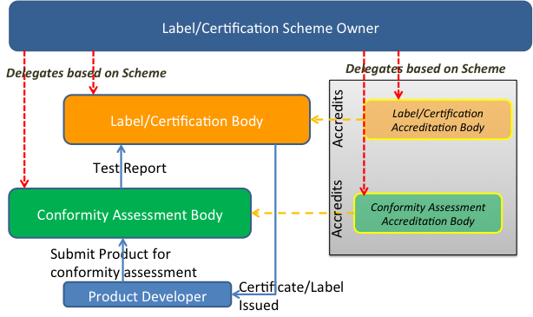
Quality label and Certification Functional Model
Notes:
The label certification scheme owner initiates the certification process and defines the certification program and process. This body delegates to the label/certification body the activity of issuing the label or certificate if the certification body is an accredited body (conform to ISO 17065 in eHealth interoperability). The label/certification body is supported by one or more Conformity Assessment Bodies. Their role is to perform the tests on the products and report to the Label/Certification body that grants or refuses the certificate. The testing laboratory (or inspection body, depending of the definition of the certification scheme) shall be ISO 17025 accredited for the specific label/certification scheme.
A variant of this model is implemented in Belgium, Certification Scheme Owner and Certification Body being two independent public instances while the Conformity Assessment Body is a private organisation contracted by the authorities.
If the testing laboratory is not ISO17025 accredited and the label/certification body is not ISO 17065 accredited, a quality label is issued rather than a certificate.
In the real life, the reference model as described here is not often adopted in eHealth interoperability field. Several models were compiled in the HITCH and EHR-Q^{TN} studies. Two main models are generally implemented:
Model-1: the same organization defines the conformity assessment scheme, organises the certification process and issues the label/certificate;
Model-2: the same organization organises all the processes including the testing services.
Although the Certification Scheme Owner, the Certification Body and the Conformity Assessment Body are described as different bodies, in practical/real life it is common to find organisations performing more than one of these roles depending on the certification scheme they support. In the case where two of three functional activities are supported by the same organisation, these functions shall be clearly separated (supported by different entities within the organization).
Note that the right hand-side of this figure introduced the entities that perform the inspection and “accredit” the left hand-side entities that perform the conformity assessment and issue certificates/labels. When an accreditation is required it is expected that it is performed by an independent third party.
This is a functional depiction in the sense that each certification and testing scheme may organize these entities in many different ways and set drastically different levels of rigors in performing their role.

Slide 41
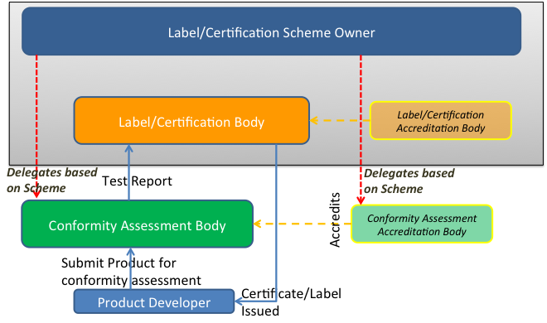
Implementation: Model 1 Labeling by eHealth project using accredited testing lab(s)
Notes:
In this model, only the testing services are performed by the conformity assessment bodies that are or not accredited bodies. This is one of the two most common implementation models. For example, this model is used by epSOS project.

Slide 42
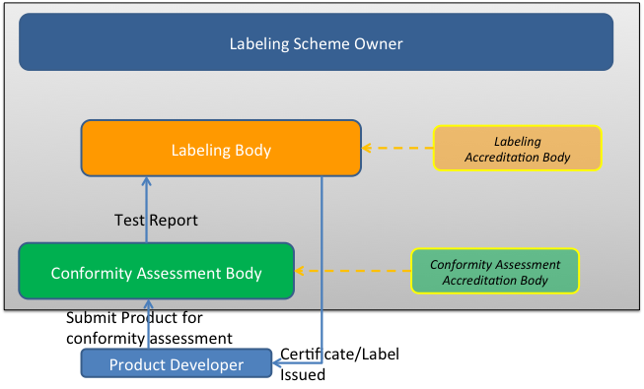
Implementation: Model 2 Labeling & testing by eHealth project (no third party accreditation)
Notes:
In this implementation model, all the activities from the definition of the Labelling scheme to the tests and the grant of the label are perfomed by the same organization, accredited or not for one or more of its activities. This model is generally implemented by an institution that is supervised by a national authority (see the French DMP example, annex II). It is not a certificate recognized at the international or European level that is issued but the goal is to meet the regulation of the country.
Many other variants exist. These processes are typically referred to as Quality Labelling as the oversight is performed internally (no third party accreditation). Impact of these models (cost/complexity/rigor/neutrality) has to be analysed but recommendations are presented and discussed in the guidelines and roadmap section.

Slide 43
Case Studies
Out of several implementations in Europe, two case studies are described in Antilope
DMP in France
epSOS as trans-European implementation
Main conclusions
Coverage with eHealth European Interoperability Framework is satisfied
Certain level of quality is guaranteed
No harmonized Quality Labelling & Certification processes
Problem of equivalence of processes

Slide 44
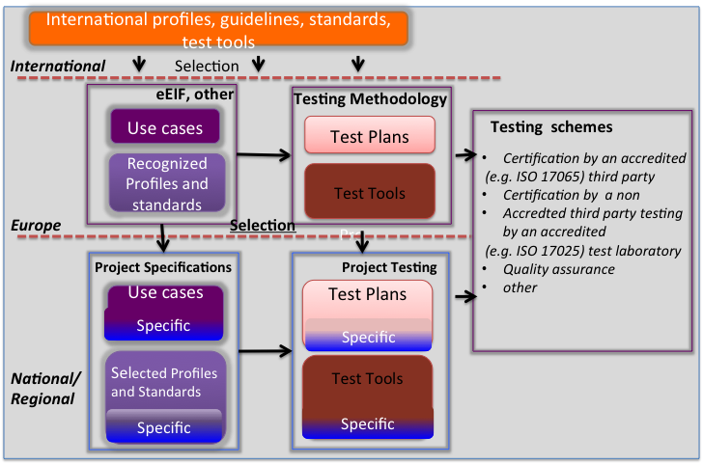
The Quality Label and Certification processes (1/2)
Notes:
To assure the consistency and sustainability between the three levels, the following process should be in place:
The international level provides international Standards and Profiles, guidelines, and tools validated by consensus As a Member of the international committees of standard and profiles bodies, Europe and its representatives (countries, healthcare providers and suppliers) contributes heavily to the specification effort;
At the European level, experts from SDO, consortia, competence centres, … define the eHealth European interoperability Framework or any other specifications that are validated at the European level and ready to be adopted. This framework describes a set of use cases and selected Standards and Profiles including the suitable semantic terminologies. Profiles are directly selected from the existing well-implemented international profiles. A testing platform such as the IHE connectathon can be the place where the implemented use cases are tested in order to verify the robustness of the specifications of the services and profiles. A Connectathon is the first step of the quality process of this implementation. International test tools are used or new test tools are developed responding to the test plans that are provided by the international or European level;
The national/regional level develops national/regional projects that embed European services and profiles in their specifications for the implementation of their information architecture. Certification or quality label program is defined at this level that answers to the requirements of the regulation and eHealth program..
To obtain the recognition of the certificate or label delivered within a national/regional program, and to develop a single European market, these requirements are recommended:
The eHealth EIF provides most of the technical services for building the national/regional architecture for similar use cases;
Test tools and test methods from the European/international level will be reused and extended to the specificities of the country/region (regulation, new needs, …) for the national/regional certification program;
Testing laboratories or inspection bodies when certified by accreditation bodies, are recognized at the European level.
The acceptance of the seal by the end-user is based on the level of trust of the process, specifically for the quality label process. Transparency and openness are the criteria that are required as a first step of such recognition.

Slide 45
In Europe: Three key steps
1
Define the Interoperability Conformance Assessment Scheme closely related with the eEIF
2
Promote creation of accredited Conformance Assessment Bodies in Europe
3
Develop Suitable Organisation for the QL&C process

Slide 46
At the National and Regional levels
1
National and Regional Project leverage profiles recognised by eEIF and use flexibility with needed national extensions
2
Ensure that the European level certification may be used as an entry criteria at the national level
3
Organise acceptance and the recognition of profiles candidates in the eEIF based on local use cases
Notes:
Ensure that the European level certification may be used as an entry criteria
Allow maximum flexibility so that Certification and/or Testing may be nationally or regionally organized project decide), or any approach may be considered
A simple process should be included to allow, regional/national choices of profiles not yet recognized by EIF, or the submission of the need for new use cases and/or new profiles in EIF, to further extend its coverage

Slide 47
Governance
European ehealth Governance Group
(Stakeholders: Authorities, Competence Centers, User and Vendor Associations)
Interop. Framework Governance
(eEIF)
Interop. Quality Label or Certification Governance
IOP Framework Coordination
QL&C Coordination
Assessment
Cross-Border projects (e.g. epSOS specifications)
Conformance Body
SDOs and Profiling Organisations
EU Terminology Value Set Mgt Body
Projectathon
Connectathon
Other
EU project
National or regional project
EU project
EU project
National or regional project
EU project
National or Regional ehealth
Notes:
A governance shall be implemented for the sustainability of all interoperability assets that are today available at the European level. It shall take into account at least:
The maintenance and validation process of the validated eHealth EIF resulting of the Antilope’s project;
The maintenance process of the validated test plan and the list of the related test tools;
The new development of the test tools corresponding to the yearly extension of the eEIF;
The yearly Connectathon can be one of the test session that assures the first level of Quality label;
The creation and maintenance of the certification scheme;
Education and promotion at the European and national/regional levels.

Slide 48
Governance
European eHealth Governance group
All categories of stakeholders
Take decision and validates Interoperability framework and Conformance Assessment Program Scheme
Interoperability Framework coordination
Refines, selects Use cases and profiles and maintains the eEIF
Analyses and prepares all the items in order to reach the consensus before validation by the eHealth Governance Group
Conformance Assessment Scheme coordination
Specifies the Conformance Assessment Program scheme
Delegates the testing validation to the CABs
Notes:
This governance is based on the European ehealth Governance Group composed by voluntary contributors from stakeholders (nations, industry, users and other).
The following roles are also defined:
Interoperability Framework governance:
Selects and maintains the specifications and the eEIF
Establishes the consensus
Support by an Operational Coordination
Interoperability QL&C governance:
Specifies the European testing and certification scheme
Delegates the testing validation to the accredited laboratories
Support by an Operational Coordination
Quality Label/Certification body: (not represented in the schema, see model-1))
Registers the candidates for the certification
Publishes the systems that passed the certification
Process complains
Accredited Conformance Assessment Body (CAB) (ISO 17025)
Registers the systems and their configurations
Organizes the tests and validates the results
Reports to the scheme owner
To start the implementation, the model-1 should be chosen. When the QL&C is well established, the model should be updated and reorganised by splitting the different roles within several bodies in order to develop and increase the quality of products in eHealth.
At the country level, national/regional program, healthcare providers are encouraged to reuse such materials and deliverables for their own purposes. They will organize their own QL&C taken into account the European seal when it is in place. They will complete the tests requirements for their own extensions. By making their extensions public and more, their test methods and test tools on open licenses, they will encourage other country to reuse all or part of their own extensions.

Slide 49
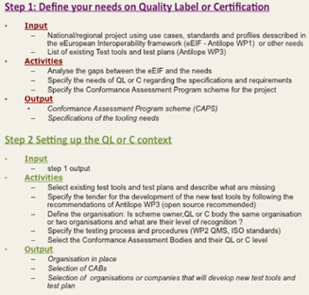
QL & Certification “in action”
4 STEPS
Notes:
The recommendations and guidelines have the objective to support any national/regional organisation to define its own processes of QL&C processes. It is structures on 4 main steps described below.
Step 1. Define the needs on Quality Label or Certification
This step provides the Conformance Assessment Scheme Program. This scheme defines the organisation of the QL&C process that was selected, the governance and the involved organisations such as Conformance Assessment Bodies, the scope of the conformance assessment.
This scheme is partly based on the European CAS and partly based on the specificities of the project(s) that the solution will be evaluated. The owner of the national/regional CAPS will therefore benefit on the European framework and by doing this, he will participates to the harmonization effort in Europe.
The main activities are listed in the figure 7. The main output of this step is the Conformance Assessment Program Scheme and its governance.
Step 2. Setting up the quality label or certification
The objective of this step is to organise the QL or C in the country or region. Organisations and/or bodies are nominated or selected in order to implement the QL or C process. The tools needed for managing, testing are specified and selected and the new tools will be specified in tender. All the procedures are defined and implemented.
The main outputs of this step are the selection of the organisations or companies that will develop the needed new tools.

Slide 50
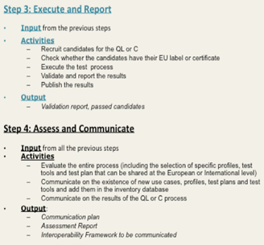
QL & Certification “in action”
4 STEPS
Notes:
Step 3. Execute and report
At this step, the testing process is executed, starting by the selection of candidates (companies, institutions or any other organisations developing solutions that will be testing against specifications, standards or profiles including in the scope of the CAPS). The results are validated and the main output of the step is the publication of the passed solutions.
Step 4. Assess and Communicate
The assessment of the process has the objective to give feedback that helps for the improvement of the QL or C process. The communication supports the promotion of the availabilities of the new use cases, test plan, new tools and test plans and a synthesis of the assessment report that can be reused by other countries or regions. Sharing experience and results are the main outputs.

Slide 51
Key Recommendations
Stimulate the creation of European market based on the evolving European eHealth Interoperability Framework and on a modular European Conformance Assessment Program
Harmonise the quality label and certification processes in Europe and among countries and regions
Propose a European interoperability quality label and certification process that allows for flexible national or regional approaches
Notes:
Three main messages were extracted from Antilope results regarding the recommendatiions of the preceding projects
Key message 1 answers to the question of what are the key elements that will support the development of the EU market
Key message 2 answers to the question of how do we avoid duplication effort or inconsistency in the market at the European and national levels
Key message 3 answers to the question of how to take into account the national or regional needs that will be declined in term of interoperability extensions and their testing.
all these messages are developed in this presentation

Slide 52
Antilope – Testing tools
Notes:
Quality Labelling and Certification provide reliable results when the tools used are quality assessed. This includes that all elements and context remaining the same, the same test tools will get the same results.

Slide 53
Key messages on testing tools
Testing tools are key to achieving interoperability | Testing and certification of eEIF Use Cases is relying on recognized profiles and will require robust and high quality testing tools
Use good testing tools that exist | ANTILOPE is contributing by consolidating and disseminating the knowledge about the testing tools already available.
New or improved test tools need to be developed | ANTILOPE is identifying the gaps and will stimulate the development of required additional capabilities of testing tools

Slide 54
Testing tools gap analysis process
eEIF Use Cases
ANTILOPE refined Use Cases
Selection of Profiles and underlying standards adapted to the Use Cases
Existing Testing Tools for Selected Profiles and standards
Gaps in existing testing tools
Notes:
The eEIF Use Cases can be realised using IHE or Continua profiles
Testing relevant profiles will test the Use Cases as well
For each of the profiles existing testing tools were identified and analysed
Gaps were identified and documented

Slide 55
Main ANTILOPE objectives for testing tools
Identify existing & new testing tools required to cover the selection of Use Cases described in the eHealth European Interoperability Framework (eEIF) and their refinement
Promote the use of existing testing tools
Promote the development of required new or improved testing tools

Slide 56
Existing Testing Tools Information Diagram
Name
Location
Developer
Testing Tool
Info Pages
Associated Profile
Source Code
Use: web/local
Tool Category
Tool enhancing information
Notes:
The information extracted for each profile specific tool:
Tool name
Developed by
Tool location
Info pages
ANTILOPE analysis highlighted some particularly important testing tool characteristics:
Use (web or local)
Access to source code
Tool category
This resulted with a number of tables presenting the available testing tools

Slide 57
Testing tool categories: Test management tools
SUT
Exchange (commands and data)
SUT
Configure
Interacts
Configure
Interacts
Value Sets
Test Mgt
Test Plan
Get Test Plan
Find Test Partner
Log Evidences
Get Test Report
TF Model
Get Test Plan
Find Test Partner
Log Evidences
Get Test Report
© IHE
Notes:
A Test Management Tool needs to facilitate the execution of tests but may include additional functionalities that would be useful in performing the tests and collecting the results. Two distinct groups highlighted:
Tools that help organize and run large interoperability events involving large number of participants and a large number of tests.
Typically manage test scenarios for peer-to-peer tests and may also support test planning and setup for large test events.
May support the configuration process for all participating communication partners (e. g. IP addresses, ports, etc.).
Selection of the interoperability testing partners from the pool of existing systems based on a number of criteria, including their communication capabilities and test instances required to reach the system’s certification goals for the event
May also support other functionalities such as authoring of test cases and reporting of interim and final test results to the test managers and test partners.
b) Execution frameworks that facilitate the selection of individual tests, collection of test results including evidence of tests performed such as pass/fail verdicts with corresponding traces.

Slide 58
Testing tool categories: Conformance tester
Specifications/Standards
Conformance
Tester
System Under Test
Conformance
Checks
Stimuli
Response
Vendor X
Notes:
Automated tool that is capable of checking the behaviour of the system under test.
The tester takes the role of the communication partner, provides stimuli to the system under test, collects the responses and evaluates whether the order, timing and/or content of messages sent by the system under test conform to the requirements of a given standard and profile.
Advanced testers may take the roles of all entities that are communicating with the system under test.
Conformance tester tools vary in the extent to which they test the requirements in the profile. The simplest testers may only check some requirements, for example message or document syntax. Advanced conformance testing tool would check most or all important requirements.
Depending on the level of precision in reporting problems discovered, conformance tester tools can provide valuable aid in rapid discovery and resolution of interoperability problems.

Slide 59
Testing tool categories: Interoperability validators
Specifications/Standards
Interoperability
validators
Conformance
Checks on query
Conformance
Checks on response
System A
Query message
System B
Response message
Vendor A
Vendor B
Notes:
Automated tool that is checking the behaviour of two systems that are interoperating.
Collects the messages exchanged between the two interacting systems and evaluates the order and/or content of messages exchanged against the requirements set by the profile.
Just like conformance testers, the Interoperability validator tools vary considerably in their checking capabilities.
In addition, the level of automation in triggering testing activities and in collecting the test traces can be quite different.

Slide 60
Testing tool categories: Simulators/stubs
Specifications/Standards
Interoperability
validators
Conformance
Checks on response
Simulator/Stub
Query message
System X
Response message
Vendor Y
Notes:
Automated tool that is checking the behaviour of two systems that are interoperating.
Collects the messages exchanged between the two interacting systems and evaluates the order and/or content of messages exchanged against the requirements set by the profile.
Just like conformance testers, the Interoperability validator tools vary considerably in their checking capabilities.
In addition, the level of automation in triggering testing activities and in collecting the test traces can be quite different.

Slide 61
Summarising current status of testing tools and future targets
Testing tools already exist for eEIF Use Cases
The increased use of existing tools will improve interoperability of eHealth systems implementing eEIF Use Cases
In addition to immediate use of existing tools, improved testing tools should be developed to increase the testing precision and productivity
Improvements that could be targeted at this point in time are already identified
A Request For Proposal to develop new or improved testing tools will be issued
As the eEIF evolves, there should be a continuous process of review , development and deployment of improved testing tools

Slide 62
Quality Manual for Interoperability Testing “Requirements for entities performing Interoperability Testing”
Notes:
Quality Labelling and Certification, using (interoperability) test tools will increase interoperability of eHealth systems, provided that these tools and procedures as well as the professionals involved are themselves subject to quality assurance.

Slide 63
Key messages
A Quality Management System will ensure continuous improvement of Interoperability
Quality Management of Interoperability Testing will improve eHealth deployment
A Quality Management System for interoperability testing will facilitate the adoption of International eHealth standards

Slide 64
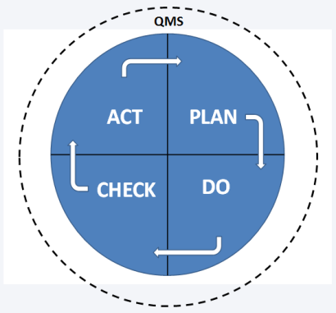
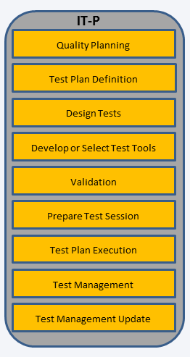
Quality Manual for Interoperability Testing
Part I
D2.1 Quality Management System
Part II
D2.2 Interoperability Testing Processes
CAB
Requirements for the operation of Conformity Assessment Bodies performing
Interoperability Testing
V3.0 16.03.2011
Notes:
Quality Management (related to interoperability testing) addresses two aspect: the organisations and stakeholders involved in quality labelling and certification on one hand, the interoperability testing processes.

Slide 65
Quality Management System (one definition)
A Quality Management System is a set of interrelated or interacting elements
that organisations use to direct and control
how quality policies are implemented and quality objectives are achieved.
Source: ISO 9000: Quality Management Systems

Slide 66
Quality Management levels
Policy statements including clear objectives derives from the policy
Description of processes – how to policy statements are implemented
Supporting documents to be used to implement the policies

Slide 67
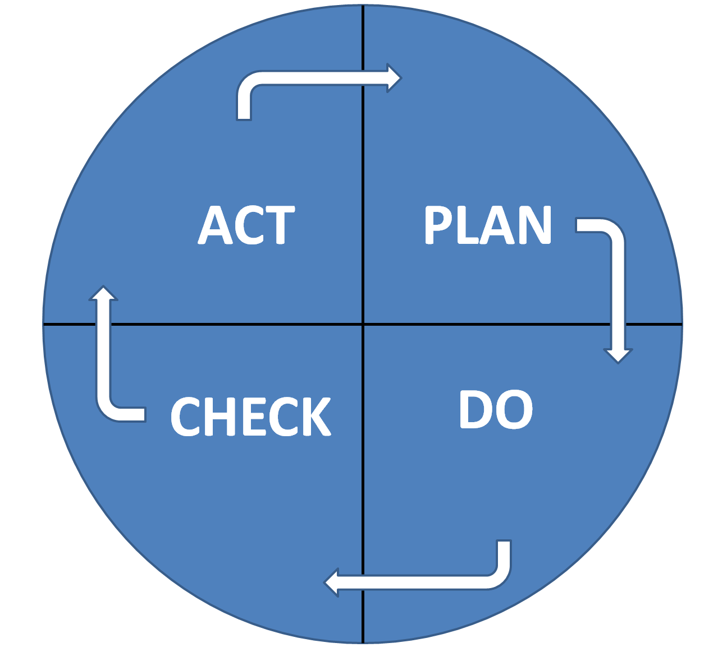
Quality Management System and the PDCA cycle
How to improve
next time?
What to do?
How to do it?
Do what was
planned
Did things happen
according to the plan?
Source: The Deming wheel (named after W. Edwards Deming).
A model for continuous improvement.

Slide 68
Quality Management at organisation level
Organisation
Management system
Document control
General procedures
Approval and issue
Changes
Review of requests, tenders and contracts
Complaints handling

Slide 69
Quality Management at organisation level (2/2)
Control of nonconforming testing work
Corrective action
Cause analysis
Selection and implementation of corrective actions
Monitoring of corrective actions
Improvement
Preventive action
Control of records
Technical records
Internal audits
Management reviews

Slide 70
Requirements for: Personnel and test methods
Personnel
ensure the competence of all who perform test, evaluate results, and sign test reports
formulate the goals with respect to the education, training and skills of the Interoperability Test entity
use personnel who are employed by, or under contract to, the Interoperability Test entity
maintain job descriptions for managerial, technical and key support personnel involved in tests
Test methods
Use methods and procedures as described in the Quality Manual Part II. D2.2 Interoperability Testing Processes.

Slide 71
Quality Manual for Interoperability Testing “Interoperability Testing Processes”
Notes:
Quality Labelling and Certification, using (interoperability) test tools will increase interoperability of eHealth systems, provided that tools and procedures are themselves subject to quality assurance.

Slide 72
Interoperability Testing Processes (IT-P): Scope
The Interoperability Testing Processes are generic and can be adjusted and customized by any Interoperability Testing entity
The Interoperability Testing Processes is a set of interconnected “guidelines” that describes how to run a test session from start to end.
Each process has defined input and output and can be maintained and improved in isolation and by different people with the required experience and skills.

Slide 73
IT-P: Actors and roles
Term | Definition
Top Level Management | The top level management coordinates the different activities. It gets reports from QA Manager, Test Manager and Auditors
QA Committee | A committee has the role to ensure the quality of the testing process, discusses the needs and decides on what needs to be done in terms of quality.
QA Manager | Manages the QA process. Gets input from the QA Committee and reports to Top Level Management.
Test Manager(TM) | Manages the testing. Organises the testing activities, reports to the Top Level Management. Follows the rules from the QA Committee to ensure the overall quality of the process
Testing team | Performs the tests and is under the supervision of the Test Manager.
System Under Test (SUT) Operators | SUT Operators execute their SUTs test steps required by the test
Auditors | Auditors verify that the QMS process is correctly used. The auditors report to the Top Level Management.

Slide 74
IT-P: Nine interconnected processes
Quality Planning
Test Plan Definition
Design Tests
Develop or Select Test Tools
Validation
Prepare Test Session
Test Plan Execution
Test Management
Test Management Update

Slide 75
Interop Testing Process Quality Mng: A generic template for each process
Why?
Objective
Work to be done
Risk planning
Roles and responsibilities
Checklist: How to adjust and localise the process description

Slide 76
Example: Test Plan Definition Why?
Interoperability Testing is a complex activity and can be clearly identified as a project on its own, with several tasks.
It is important to identify and allocate the right persons with testing skills as well as managers organising and monitoring the testing processes.
A good planning will help the individual testers to be sure that conformance and interoperability requirements are sufficient tested, independent of what person who performed the test.

Slide 77
Example: Test Plan Definition Objective
The test plan definition will describe the test strategy and its implementation.
All activities are carefully defined and planned in order to test profile specification in a given context.

Slide 78
Example: Process Test Plan Definition Work to be done
Definition of the scope and objective
Specification of the test design
Development or the selection of the test tools
Preparation of the test session:
Execution of the test session
Reporting of test results.

Slide 79
Example: Process Test Plan Definition Risk planning
The equilibrium between resources, schedule and the test design needs to be established.
A bad risk assessment and a weakness on the requirements specifications are also possible causes of failure.
If customers notice a weakness in the quality of products, they will no longer have confidence in the testing process of a particular project.
If the feedback to the organisation that has made the specification (eq. a profile for patient identification) is not well documented, the testing process has no sense or will be the bad quality.

Slide 80
Conclusions
Interoperability is one of the most critical quality issues in eHealth
Interoperability with effective reuse of clinical content requires conformity to requirements, standards and profiles .
Antilope encourages the documentation of the Interoperability requirements at European wide with respect of National and Regional specificities.
The deployment of the Interoperability that gives high value of services for a better care requires high level of quality of the services and products.

Slide 81
Conclusions
Third party quality labelling and certification are the most reliable means to prove the conformity of the eHealth services and products to international standards and profiles.
Quality label and certification processes as well as the tools used should be quality assessed, based on ISO standards.
The market and some national authorities are offering / using quality labelling and certification for functional as well as for the interoperability aspects of eHealth products.
The market will profit of a European approach to harmonise existing and future initiatives according to Antilope.

Slide 82
Thank you
More information is available on the Antilope website http://www.antilope-project.eu/

