Slide 1
Quality Label and Certification Processes Vienna Summit 11 April 2014
Karima Bourquard
Director of Interoperability
IHE-Europe

Slide 2
Testing and Certification Objectives
To design a European quality label or certification process that supports eHealth interoperability in Europe.
These processes shall operate in harmony with country specific quality label or certification processes
Main benefits:
For Healthcare providers
A harmlonized European market for the eHealth solutions
Better integration between solutions
Ability to exchange electronically medical data between Regions and Nations
For Industry
One recognized quality label or certification process in Europe
Avoid duplication between the national and regional testing processes
Factor and mutualize specifications elements and corresponding testing tools
Notes:
To develop a unified market in Europe, the stakeholders need to be confident that ICT solutions that are procured meet specific standards and profiles, even if the solutions are proposed by companies coming from other countries than the country of the healthcare provider. Establishing a quality label or certificate at the European level, will leverage the integration of solutions within the country and allow the exchange of information between countries and/or region. It also offers a good opportunity for the industry to market their products in Europe within one recognized testing process, avoiding duplicate testing and inconsistencies among different testing processes.

Slide 3
HITCH Roadmap
Get ready 2012-2013
Operationalize 2013-2014
Deploy 2015-20XX
eEIF
European Strategic Milestones
Ehealth Interoperability
Framework
Evaluation of Testing & LabelCert.
Pilot Testing & LabelCert.
EuropeanTesting & LabelCert.
Operational
Testing & Certification Processes
European-Level
QMS V1.0
European-Level
QMS V2.0
Proposed European-Level Testing Process
European-Level Testing Process
Support of Project-Level Testing & LabelCert Process
Proposed European-Level LabelCert. Process
European-Level LabelCert Process
Testing Tools
Interop/functional Linkage
Testing Management Platform V1.0
Test Management Platform V2.0
Support of Project-Level Testing Tools
Test Methodology
Test Cases V1.0
Test Cases V2.0
Test Tools V1.0
Test Tools V2.0
Notes:
HITCH: Healthcare Interoperability Testing and Conformance Testing
Antilope : Adoption and take up of standards and profiles for eHealth
HITCH is an European project that conducted in 2010 and 2011. The main results were the QMS first version, the state of art on test tools and a state of art and recommendations on certification processes organised by countries or consortium/associations. HITCH provided recommendations and an implementation roadmap.
This project antilope is continuing from previous projects and studies. It started in 2013 and finishes end of 2014. One of the objectives of Antilope is to improve the HITCH deliverables by refining and updating them (eEIF and HITCH Interoperability QMS), update (test tools). Antilope specifies the EU Label/Certification processes and its governance taking into account the recommendations delivered by HITCH and EHRQTN.
The results of the ANTILOPE project is promoted and validated during 10 summits held throughout Europe.

Slide 4
Key Recommendations
Stimulate the creation of European market based on the evolving European eHealth Interoperability Framework associated with a modular European Conformance Assessment Program
Harmonize the quality label and certification processes in Europe and among countries and regions
Propose a European interoperability quality label and certification process that allows for flexible national or regional approaches
Notes:
Three main messages were extracted from Antilope results regarding the recommendatiions of the preceding projects
Key message 1 answers to the question of what are the key elements that will support the development of the EU market
Key message 2 answers to the question of how do we avoid duplication effort or inconsistency in the market at the European and national levels
Key message 3 answers to the question of how to take into account the national or regional needs that will be declined in term of interoperability extensions and their testing.
all these messages are developed in this presentation

Slide 5
Recommendations from previous projects
-----------
HITCH
(Healthcare Interoperability Testing and Conformance Harmonisation)
EHR-Q^{TN}
(EHR Quality Labelling)

Slide 6
HITCH Project Recommendations
1
Develop an European ecosystem by promoting recognized profiles, test plans and test tools
2
Define flexible testing processes
3
Provide a European Interoperability Assessment Scheme
Notes:
The Hitch project (Healthcare Interoperability Testing and Conformance Harmonisation) is an European project that provided recommendations and a proposed roadmap for achieving sustainable and effective deployment of the testing and certification/labelling process to enable health information exchange interoperability within and between European member states. One of the recommendations is the “Establishment a two-level Labelling and Certification process (European Level and National/project Level)”, one of the topic of the Antilope project. This recommendation is related to the “preservation of flexibility across the proposed Labelling and Certification schemes”.
Various approaches of labelling and certification scheme were analysed in the HITCH project in terms of benefits and limitations. It was concluded that the choice of one or another depends of the
The maturity of the market;
The cost of product development and administrative processes;
The scale of diffusion of interoperability and the emergence of new interoperability profiles;
The legal framework relating to patient safety and security of exchanged or shared medical data.
The two level labelling and certification process was limited to the schemes that includes as specifications to be qualified the recognized standards and profiles at the European level i.e the eHealth European Interoperability Framework available today. It was also proposed to develop an European ecosystem by building and evolving the European IHE testing process. By promoting European recognized standards and profiles, test plans and test tools, this will ensure the consistency between European and national/regional levels.
The roadmap that was described in the HITCH project, proposes first versions of the eEIF and the labelling/certification process in 2012-2013 (see previous slide).

Slide 7
EHR-Q^{TN} Project Recommendations
1
Apply generic criteria of quality to the initiatives
(independence, openness, impartiality, transparency and confidentiality)
2
Involve stakeholders to the definition of the priorities in defining feasible goals
3
Structure the Quality label and Certification processes in line with ISO standards
Notes:
One of the work packages of the project was dedicated to propose a state of art of the national certification processes as well as of the EuroRec quality labelling procedures and scenarios. Even if this study is not oriented interoperability assessment but procedures on testing functions of the EHR systems including data exchanges, it gives a clear overview on the quality labelling and certification process and clarify concepts, definition and deployment and such a process.
One of the conclusions of the study was to propose generic criteria that all quality labelling or certification initiatives must follow:
Independence, encompassing discretion and confidentiality, impartiality, openness and a clear and distinct role of each of the stakeholders involved in the process;
High quality documentation of the initial set of criteria, of the evaluation rules and of the testing results;
The involvement of all stakeholders in defining priorities and feasible goals, considering national and regional variation;
Rules regarding validity and use of the Quality Label or Certificate and possible measure against misuse.
The EHR-Q^{TN} project heavily focused on structuring the Quality Labelling and Certification process based on and ruled by international standards, distinguishing
Accreditation Body, mandatory member of the IAF – International Accreditation Form and regulated by law, based on ISO/IEC 17011 and accrediting the Certification Bodies;
Certification Body, organising quality labelling and certification processes and according either quality labels or certificates, compliant to ISO/IEC 17020. Certificates are only granted by accredited certification bodies;
Conformity Assessment Bodies, recognised and/or contracted by the Certification Bodies to perform the effective testing of products and services in a way compliant to ISO/IEC 17010.
The EHR-Q^{TN} project issued a number of recommendations addressing legal and regulatory framework, involvement of the different stakeholders, the technical framework as well as the quality labelling and certification process as such.
The EHR-Q^{TN} project highlighted the important role of the European and National Authorities initiating the process, based on incentives and a third party quality assessment.
Quality labelling and certification sustainability was also discussed. The starting point for any quality assessment or certification depends of the decision to go for it. The business model depends on who takes the decision (it means who is the owner of the assessment scheme).
Sustainability of quality labelling and certification activities is possible in the medium long term (3 to 5 years) depending on the political, social and economical pressures as well as on the availabilities of the resources from industry, buyers or authorities.

Slide 8
Testing, Quality labelling and certification processes
Functional Model

Slide 9
Quality Label and Certification processes - Definitions
QL & C processes
Requirements, activities and tasks to support an entity in organizing high quality interoperability assurance or certification
Conformity assessment
demonstration that specified requirements relating to a product, process, system, person or body are fulfilled (ISO/IEC 17000)

Slide 10
Functions
A certification or quality label process requires:
A Certification/Label Scheme Owner: a party that sets the Certification or a quality label program or system;
A label/Certification Body: a party that issues the quality label or certificate on the basis of the conformity assessment performed by a conformity assessment body;
A Conformity Assessment Body: a party that assesses the conformity of products, services and/or suppliers (often called a testing laboratory)
Notes:
A quality label or a certification processes define all requirements, activities and tasks that allow any entity that wants to organize a quality assurance procedure or certification and for the entities that want to seek this quality label or certification. A certification or quality label process requires:
A QL&C Scheme Owner: a party that sets the QL&C program or system;
A Certification Body: a party that issues the quality label or certificate on the basis of the conformity assessment performed by a Conformity Assessment Body;
A Conformity Assessment Body: a party that assesses the conformity of products, services and/or suppliers (sometimes called a testing laboratory)

Slide 11
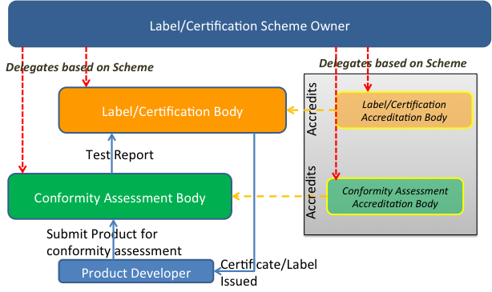
Quality label and Certification Functional Model
Notes:
The label certification scheme owner initiates the certification process and defines the certification program and process. This body delegates to the label/certification body the activity of issuing the label or certificate if the certification body is an accredited body (conform to ISO 17065 in eHealth interoperability). The label/certification body is supported by one or more Conformity Assessment Bodies. Their role is to perform the tests on the products and report to the Label/Certification body that grants or refuses the certificate. The testing laboratory (or inspection body, depending of the definition of the certification scheme) shall be ISO 17025 accredited for the specific label/certification scheme.
If the testing laboratory is not ISO17025 accredited and the label/certification body is not ISO 17065 accredited, a quality label is issued rather than a certificate.
In the real life, the reference model as described here is not often adopted in eHealth interoperability field. Several models were compiled in the HITCH and EHR-Q^{TN} studies. Two main models are generally implemented:
Model-1: the same organization defines the conformity assessment scheme, organises the certification process and issues the label/certificate;
Model-2: the same organization organises all the processes including the testing services.
Although the Certification Scheme Owner, the Certification Body and the Conformity Assessment Body are described as different bodies, in practical/real life it is common to find organisations performing more than one of these roles depending on the certification scheme they support. In the case where two of three functional activities are supported by the same organisation, these functions shall be clearly separated (supported by different entities within the organization).
Note that the right hand-side of this figure introduced the entities that perform the inspection and “accredit” the left hand-side entities that perform the conformity assessment and issue certificates/labels. When an accreditation is required it is expected that it is performed by an independent third party.
This is a functional depiction in the sense that each certification and testing scheme may organize these entities in many different ways and set drastically different levels of rigors in performing their role.

Slide 12
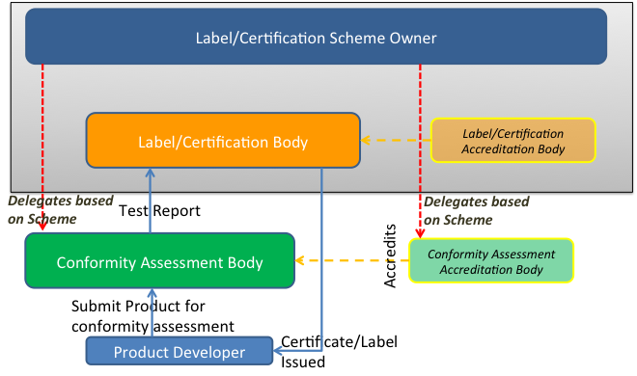
Implementation: Model 1 Labeling by eHealth project using accredited testing lab(s)
Notes:
In this model, only the testing services are perfromed by the conformity assessment bodies that are or not accredited bodies. This is one of the two most common implementation models. For example, this model is used by epSOS project (see annex I).

Slide 13
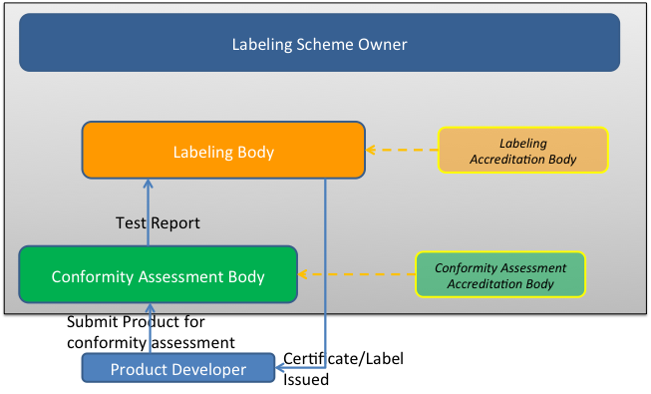
Implementation: Model 2 Labeling & testing by eHealth project (no third party accreditation)
Notes:
In this implementation model, all the activities from the definition of the Labeling scheme to the tests and the grant of the label are perfromed by the same organization, accredited or not for one or more of its activities. This model is generally implemented by an institution that is supervised by a national authority (see the French DMP example, annex II). It is not a certificate recognized at the international or European level that is issued but the goal is to meet the regulation of the country.
Many other variants exist. These processes are typically referred to as Quality Labeling as the oversight is perfromed internally (no third party accreditation). Impact of these models (cost/complexity/rigor/neutrality) has to be analysed but recommendations are presented and discussed in the guidelines and roadmap section.

Slide 14
Case Studies

Slide 15
Case study-1 : DMP in France
Objective :
DMP is the national PHR/EHR in France
The process called “homologation” is described in detail in the annex II. The goal of the « homologation » is to validate that the healthcare software connected to the DMP (French National PHR) are conform with the DMP specifications.
Specifications defined by ASIP Santé (national agency) based on IHE profiles, HL7 and DICOM
Access to the DMP
INS (National Identification of the Patient)
Creation and management of the DMP
Registration of medical documents in the DMP
Consultation of the DMP
Other services
Label/Certification scheme defined by ASIP Santé
Notes:
The process called “homologation” is described in detail in the annex II. The goal of the « homologation » is to validate that the healthcare software connected to the DMP (French National PHR) is conformed with the DMP specifications.
The specifications describe the external interfaces used to connect any software to the DMP and are available at (http://esante.gouv.fr/sites/default/files/DMP1_LPS_TEC_DSFT_des_interfaces_LPS_20120724_v1.0.zip ). These specifications are based on several IHE profiles such as IHE-XDS, IHE-PDQ, ATNA, XUA, HL7 v3 CDA r2, and HL7 v3 administrative messages, SAML and TLS.

Slide 16
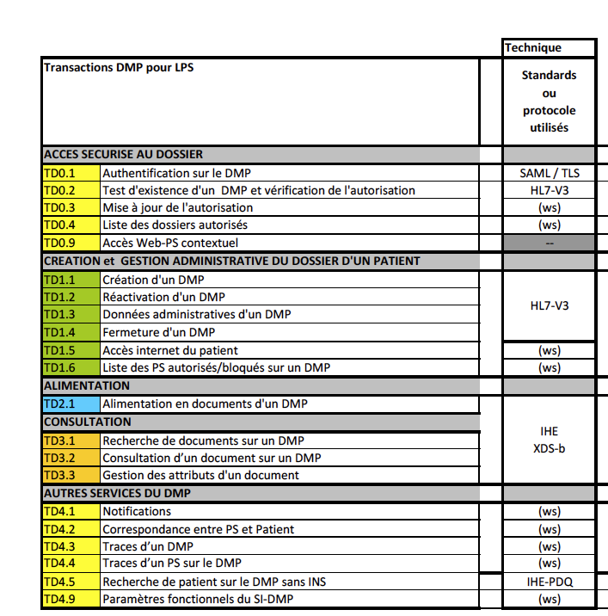
Case study – 1 : DMP in France
Step 1
Registration of the Vendor to the process (ASIP Santé)
Registration and published candidates for DMP compatibility
Step 2
Access to the test environment
Access to the support
Pre-Homologation: upload files and validation of the tests
Step 3
Homologation and testing validation
Update and bugs resolution
Final decision by the committee and publication of
the results
Label (Homologation) Process
Mapping Services/Standards and Profiles
Notes:
The process is more an quality label process than a certification process launched by the national agency called ASIP Santé. ASIP Santé founded in 2009 by the French authorities, is a national agency that the role is to strengthen public ownership of the Information System developed in the Healthcare sector.
The national agency Asip Santé provides specifications, develops test tools and test plan, organises the testing sessions, reports and validates the results. The Asip Santé is neither a certified body nor a accredited laboratory/inspection body. The implementation model is the model- 2.
However the Asip Santé provides a guarantee of a certain level of quality of the implementation of the profiles and standards by the products, related to the DMP architecture.
The coverage with the eHealth European Framework is quite satisfied regarding the use cases. The products that have their “homologation” could be well accepted by other project.

Slide 17
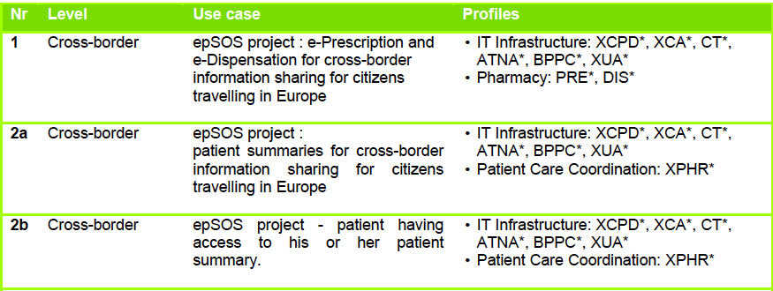
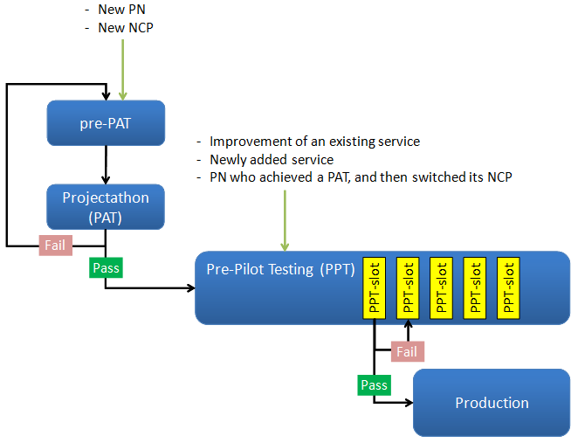
Case study – 2 : epSOS project
eEIF
UC1 , UC2a UC2b
epSOS Specifications
IHE Profiles
epSOS Testing Process
Test Plans
Testing Tools
Notes:
The testing strategy is deeply described with four phases. The testing phase itself was delegated to IHE-Europe that develops test methods and test tools and organized the two categories of test sessions: face to face meetings (projectathon) and virtual sessions (Pre Pilot testing). IHE-Europe reports the results of the tests to the epSOS project Steering committee that the role is to validate the results for each nation or participant. The implementation model corresponds to the model- 1.
The question of the sustainability is still open today. A governance must be defined in order to maintain all the epSOS assets as well as the eEIF (see section 6.1.3).

Slide 18
Harmonisation of the quality label or certification processes in Europe

Slide 19
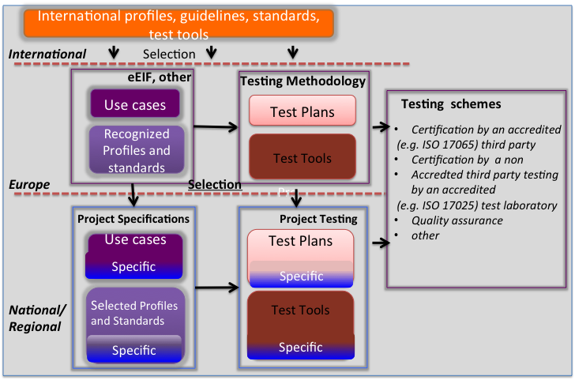
The Quality Label and Certification processes (1/2)
Notes:
To assure the consistency and sustainability between the three levels, the following process should be in place:
The international level provides international Standards and Profiles, guidelines, and tools validated by consensus As a Member of the international committees of standard and profiles bodies, Europe and its representatives originating from countries, healthcare providers and suppliers contributes heavily to the specification effort;
At the European level, experts from SDO, consortia, competence centres, … define the eHealth European interoperability Framework (see WP1) or any other specifications that are validated at the European level and ready to be adopted. This framework describes a set of use cases and selected Standards and Profiles including the suitable semantic terminologies. Profiles are directly selected from the existing well-implemented international profiles. A testing platform such as the IHE connectathon is the place where the implemented use cases are tested in order to verify the robustness of the specifications of the services and profiles. A Connectathon is the first step of the quality process of this implementation. International test tools are used or new test tools are developed responding to the test plans that are provided by the international or European level;
The national/regional level develops national/regional projects that embed European services and profiles in their specifications for the implementation of their information architecture. Certification or quality label program is defined at this level that answers to the requirements of the regulation and eHealth program..
To obtain the recognition of the certificate or label delivered within a national/regional program, and to develop a single European market, these requirements are recommended:
The eHealth EIF provides most of the technical services for building the national/regional architecture for similar use cases;
Test tools and test methods from the European/international level will be reused and extended to the specificities of the country/region (regulation, new needs, …) for the national/regional certification program;
Testing laboratories or inspection bodies when certified by accreditation bodies, are recognized at the European level.
The acceptance of the seal by the end-user is based on the level of trust of the process, specifically for the quality label process. Transparency and openness are the criteria that are required as a first step of such recognition.

Slide 20
In Europe: Three key steps
1
Define the Interoperability Conformance Assessment Scheme closely related with the eEIF
2
Promote creation of accredited Conformance Assessment Bodies in Europe
3
Develop Suitable Organisation for the QL&C process

Slide 21
At the National and Regional levels
1
National and Regional Project leverage profiles recognized by eEIF and use flexibility with needed national extensions
2
Ensure that the European level certification may be used as an entry criteria at the national level
3
Organise acceptance and the recognition of profiles candidates in the eEIF based on local use cases
Notes:
Ensure that the European level certification may be used as an entry criteria
Allow maximum flexibility so that Certification and/or Testing may be nationally or regionally organized project decide), or any approach may be considered
A simple process should be included to allow, regional/national choices of profiles not yet recognized by EIF, or the submission of the need for new use cases and/or new profiles in EIF, to further extend its coverage

Slide 22
Governance
European eHealth Governance group
All categories of stakeholders
Take decision and validates Interoperability framework and Conformance Assessment Program Scheme
Interoperability Framework coordination
Refines, selects Use cases and profiles and maintains the eEIF
Analyses and prepares all the items in order to reach the consensus before validation by the eHealth Governance Group
Conformance Assessment Scheme coordination
Specifies the Conformance Assessment Program scheme
Delegates the testing validation to the CABs
Notes:
This governance is based on the European ehealth Governance Group composed by voluntary contributors from stakeholders (nations, industry, users and other).
The following roles are also defined:
Interoperability Framework governance:
Selects and maintains the specifications and the eEIF
Establishes the consensus
Support by an Operational Coordination
Interoperability QL&C governance:
Specifies the European testing and certification scheme
Delegates the testing validation to the accredited laboratories
Support by an Operational Coordination
Quality Label/Certification body: (not represented in the schema, see model-1))
Registers the candidates for the certification
Publishes the systems that passed the certification
Process complains
Accredited Conformance Assessment Body (CAB) (ISO 17025)
Registers the systems and their configurations
Organizes the tests and validates the results
Reports to the scheme owner
To start the implementation, the model-1 should be chosen. When the QL&C is well established, the model should be updated and reorganised by splitting the different roles within several bodies in order to develop and increase the quality of products in eHealth.
At the country level, national/regional program, healthcare providers are encouraged to reuse such materials and deliverables for their own purposes. They will organize their own QL&C taken into account the European seal when it is in place. They will complete the tests requirements for their own extensions. By making their extensions public and more, their test methods and test tools on open licenses, they will encourage other country to reuse all or part of their own extensions.

Slide 23
Guidelines and recommendations

Slide 24
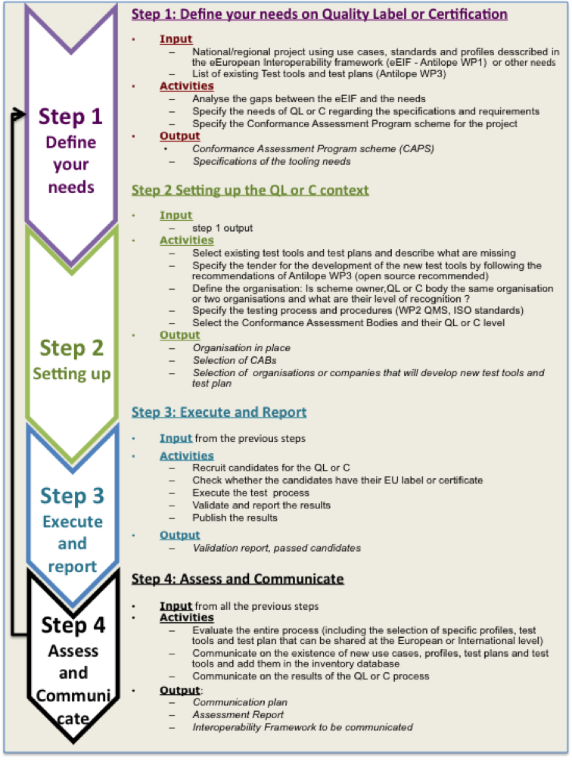
How to deploy QL & C processes
In your organisation, region, or
Nation ?
4 STEPS
Notes:
The recommendations and guidelines have the objective to support any national/regional organisation to define its own processes of QL&C processes. It is structures on 4 main steps described below.
Step 1. Define the needs on Quality Label or Certification
This step provides the Conformance Assessment Scheme Program. This scheme defines the organisation of the QL&C process that was selected, the governance and the involved organisations such as Conformance Assessment Bodies, the scope of the conformance assessment.
This scheme is partly based on the European CAS and partly based on the specificities of the project(s) that the solution will be evaluated. The owner of the national/regional CAPS will therefore benefit on the European framework and by doing this, he will participates to the harmonization effort in Europe.
The main activities are listed in the figure 7. The main output of this step is the Conformance Assessment Program Scheme and its governance.
Step 2. Setting up the quality label or certification
The objective of this step is to organise the QL or C in the country or region. Organisations and/or bodies are nominated or selected in order to implement the QL or C process. The tools needed for managing, testing are specified and selected and the new tools will be specified in tender. All the procedures are defined and implemented.
The main outputs of this step are the selection of the organisations or companies that will develop the needed new tools and the global organisation is in place, ready to start the testing process.
Step 3. Execute and report
At this step, the testing process is executed, starting by the selection of candidates (companies, institutions or any other organisations developing solutions that will be testing against specifications, standards or profiles including in the scope of the CAPS). The results are validated and the main output of the step is the publication of the passed solutions.
Step 4. Assess and Communicate
The assessment of the process has the objective to give feedback that helps for the improvement of the QL or C process. The communication supports the promotion of the availabilities of the new use cases, test plan, new tools and test plans and a synthesis of the assessment report that can be reused by other countries or regions. Sharing experience and results are the main outputs.

Slide 25
Antilope roadmap
Get ready 2012-2013
Operationalize 2014-2015
Deploy and Maintain
2016-20XX
Build 2013-2014
Definition of the EU governance
European Strategic Milestones
Ehealth Interoperability
Framework
eEIF
Organisation and rules
in place
Pilot Testing & LabelCert.
Testing & Quality LabelCert.
Operational
Refined Ehealth Interoperability
Framework
Testing & Certification Processes
Evaluation of Testing & LabelCert.
European-Level
QMS V2.1
European-Level
QMS V1.0
European-Level
QMS V2.0
Proposed European-Level
Testing Process
Maintenance of all assets
European Conformance Assessment Program Scheme v1.0
Support of Project-Level Testing & LabelCert Process
Quality LabelCert Processes V1.0
Proposed European-Level Quality LabelCert. Process
Quality LabelCert Processes V1.1
Projects
Education
List of Test Tools V2.0
Testing Tools
Test Management Platform V2.0
Testing Management Platform V1.0
Support of Project-Level Testing Tools
Test Cases V2.0
Test Methodology
Test Cases V1.0
List of Test Tools V1.0
Test Tools V1.0
Test Tools V2.0
Notes:
HITCH: Healthcare Interoperability Testing and Conformance Testing
Antilope : Adoption and take up of standards and profiles for eHealth
The roadmap is updated with a new step before the deployment. Goovernance has to be set up

Slide 26
Next steps and conclusion
Next steps:
Collecting all the feedbacks from the summits and other conferences: January to June
New vesion to be submitted to the SEPs (experts)
Validation by the Core Group in November
Final drafts of the deliverables on January 2015
Few feedbacks received due to the complexity of the topic where expertise is needed
Benefit:
Align with ISO standards
Mutualisation and harmonisation in Europe
One QL&C processes at the EU level where derivation is described
Next activity: define the Conformity Assessment Scheme (iSPECIFICON)

Slide 27
For more information,
please refer to document D4.1.
available on the Antilope website
http://www.antilope-project.eu/

