Slide 1
Slovakia
Antilope Project

Slide 2
Slovakia
Population: 5.4 mil.∗
Number of healthcare providers: 13 109∗
Number of all health professionals: 75 834, 65∗∗
∗ Data from the year 2011
∗∗ Evidence number of health professionals in permanent and outside employment recalculated on full-time jobs

Slide 3
eHealth – 1. Project (eSO1)
Development
Beta release
UAT
Pilot
eHealth – 2. Project (NZIS)
Development
Beta release
UAT
Pilot
25.2.2014

Slide 4
Certification process of eHealth software companies is defined by Act no.153/2013 Coll.
First application is in the phase of User Acceptance Testing
Goal – national eHealth system testing in real-life conditions.

Slide 5
What we have prepared:
dedicated environment for certification tests
80 certification test cases for the start
responsible NHIC employees
continuous process – how to apply findings from real life to the certification process

Slide 6
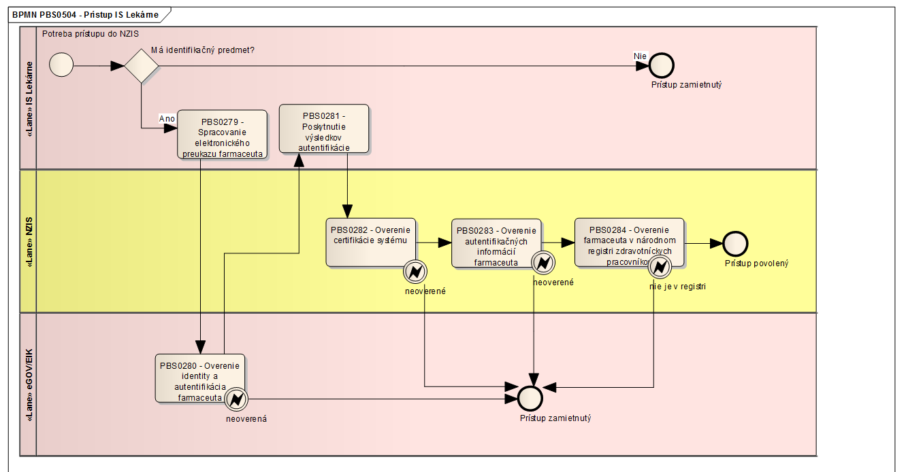
Example of test case diagram:

Slide 7
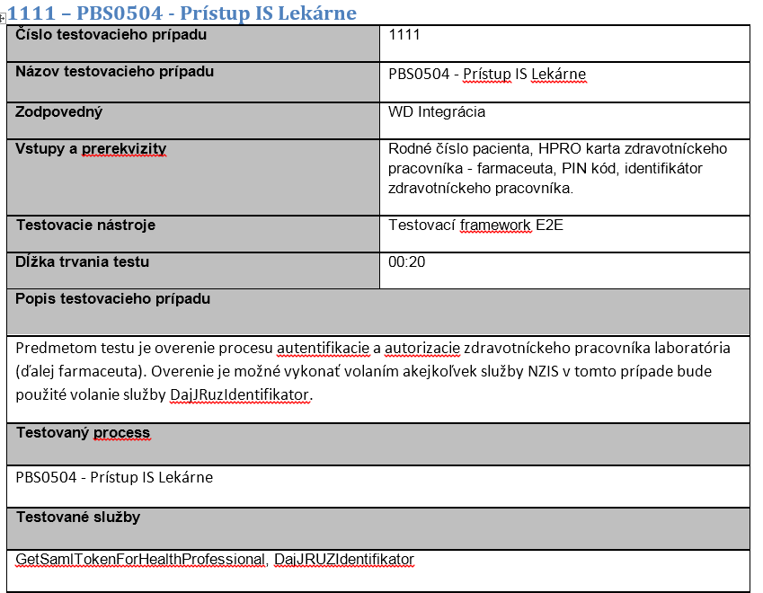
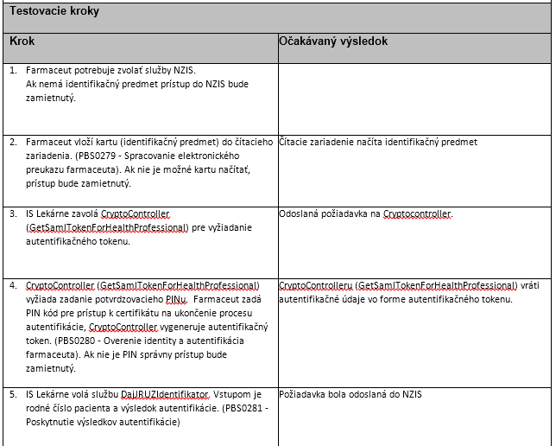
Example of test case:

Slide 8
Thank you for your attention
Ing. Martin Ďurik, PhD

Slide 9
Backup

Slide 10
Certification process:
Software company sends a request for certification
NHIC checks the system of a software company
NHIC registers the software and the version
NHIC sends the ID to the software company
The Software company inserts the ID in every XML message
NHIC system checks every message for valid software ID
NHIC generates the software certification ID

